Slide 1
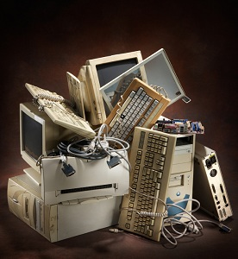
OUTSOURCING PROGRAM FOR IT-RELATED PRODUCTS AND BENEFITS TO SMEs
Present by
Wan Roz bin Wan Hussein
RF COMMUNICATION (Malaysia) SDN.BHD.

Slide 2
CONTENT
Brief introduction of RF Communication(M) Sdn.Bhd.
Our past experience in Buying and later Outsourcing IT-related product.
Benefits of Outsourcing IT-related Product.

Slide 3
Brief introduction
RF COMMUNICATION (M) SDN.BHD.
( COMPANY NO: 157169-M )
Established :
1986.
Type of Business :
System Integrator for
Scada Communications
Systems.
Customers :
Oil & Gas.
Utiliities.
Defence.
Maritime.
Market :
Malaysia.
Indonesia.
Vietnam.
Brunei.
New Zealand..
Ghana.
Somalia.
FACILITY AT :-
No.15 Jalan 1/57A, Off Bt.3 Jalan Ipoh, 51200 Kuala Lumpur, Malayisia.
Tel : 6-03-40433657 Fax : 6-03-40432193. Website : www.rfcomm.org

Slide 4
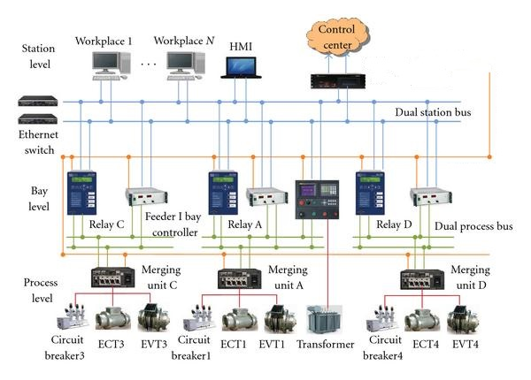
Past Experience Example of our Scada Project

Slide 5
Benefits to SME
Outsourcing is no longer about cost-saving .
It becomes a requirement especially for new SME.
30-40% manufacturers already outsourced finished product.
Outsource increase productivity and competitiveness by 50%.
You work with IT experts.
Technology has changed the way we work.

Slide 6
CONCLUSION
SME should outsourced their heavy IT-related product to reliable IT Experts and focus on your core business.
– especially when you wear many hats, from Creator, Producer, Marketer, Salesperson, Customer Service and whatever else you need to run a business.
In today’s technology a small business that experiences a computer outage lasting more than 10 days will never fully recover financially . 50% will be out of business within five years.

Slide 7
From Wan Roz bin Wan Hussein < wanroz@rfcomm.org> RF COMMUNICATION (Malaysia) Sdn.Bhd.
THANK YOU

