Slide 2


Slide 3


Slide 4
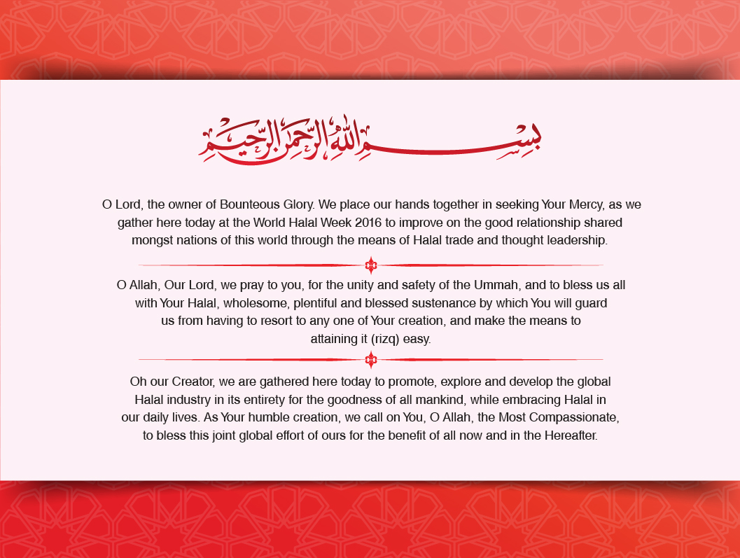

Slide 6
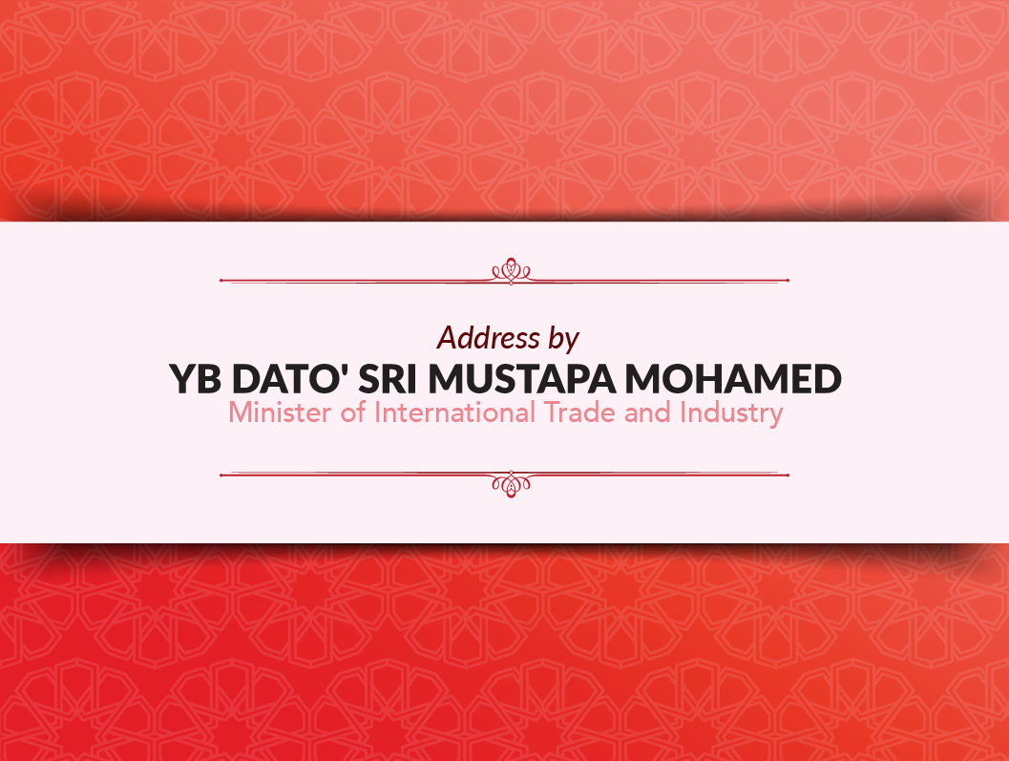

Slide 7



Slide 8
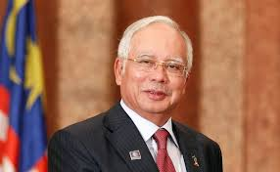
The journey
1974
Halal certification was introduced under Prime Minister’s Office
2000
Halal Assurance System was documented
HDC was established under Prime Minister’s Department
2006
2008
Halal Industry Master Plan (2008-2020) endorsed by the Malaysian Cabinet
2013
World Halal Research rebranded to World Halal Conference

Slide 9
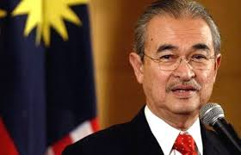
Halal Industry Master plan (2008 – 2020)
Desired Outcome
Halal as a new source of economic growth
Vision
Malaysia as the global leader in the innovation, production and trade of a number of Halal-related sectors
Malaysia as the
global reference centre
for discipline in Halal Integrity
The government has outlined holistic strategies to intensify the development of the Halal industry towards achieving the vision of making Malaysia a Global Halal Hub
- Speech at MIHAS 2007

Slide 10
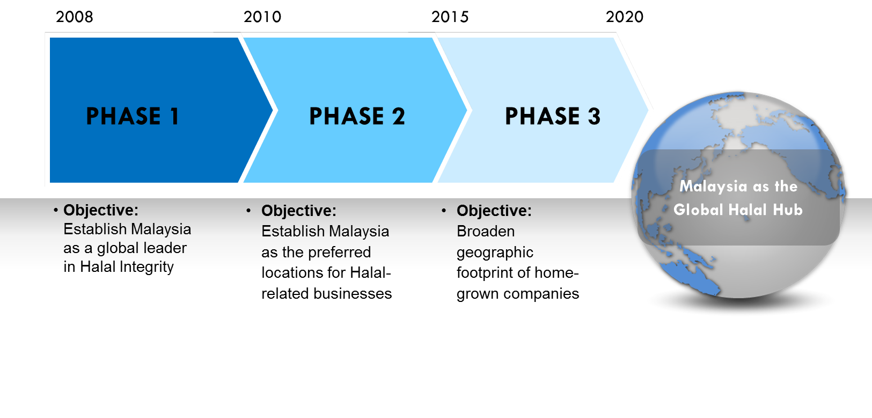
The Implementation phases

Slide 11


World Halal Week – A Premier Event
World Halal Week Theme -- "Beyond the Economy"
70
core countries, providing various opportunities
More than 1,200 delegates from more than 50 countries
89 companies from ASEAN, 78 companies from OICs
More than 300 delegates from more than 32 countries

Slide 12
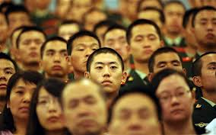
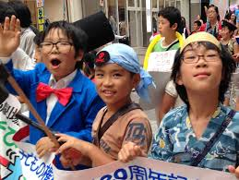
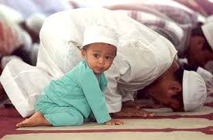
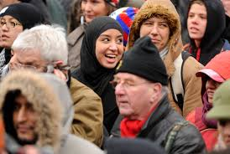
Growing interest in Halal by many countries
Given that the concept of Halal was designed to be universal
“Oh Mankind, eat what is Halal (lawful) and Thayyib (good, healthy)”

Slide 13
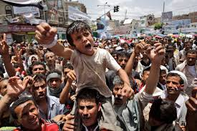
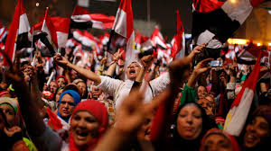
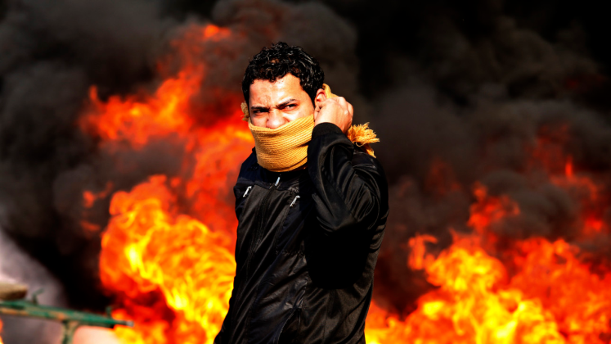
Economic agenda must remain at the forefront
Instability in certain parts of the world as a result of their actions has distorted the respective countries’ economic growth

Slide 14

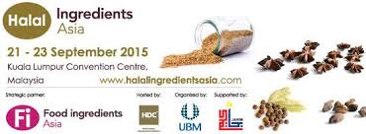

Halal Malaysia Dimension
Source of new economic growth

Slide 15
Global Halal Economic Landscape
Source of new economic growth
RM8.4 trillion GLOBAL HALAL MARKET VALUE
Global Muslim population is expected to form 27% of the global population by 2030

Slide 16
Global Recognition –
Malaysia as the World’s most advanced Islamic economy
International Halal food and lifestyle market is worth USD3.7 trillion by 2019
Malaysia scored highest in:
  Halal Food
  Islamic Finance, and
  Halal Travel

Slide 17

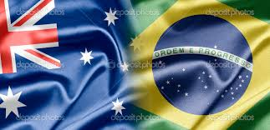
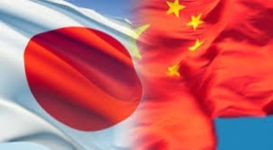
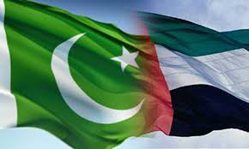
Development in other countries
Malaysia, Indonesia, Thailand, Brunei, Singapore and the Philippines all began a variety of government-led initiatives for Halal to drive economic growth
Australia and Brazil have built their entire food based industries by supplying Halal food to the Middle Eastern markets
Japan and China are aggressively promoting the development of their Halal products and services
UAE is promoting their National Mark and Pakistan is introducing a bill to set up Halal food regulatory body
Source:
Various websites

Slide 18

Halal Malaysia Achievement:
Investment
from RM4.1 billion in 2012 to RM10.6 billion in 2015
Source: HDC

Slide 19

Halal Malaysia Achievement:
Halal certified companies
from 2,336 companies in 2011 to 5,726 companies in 2015
Source: HDC

Slide 20

Halal Malaysia Achievement:
Employment
from 97,000 jobs in 2011 to almost 250,000 jobs in 2015
Source: HDC

Slide 21
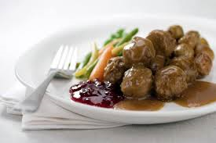
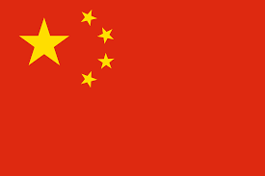



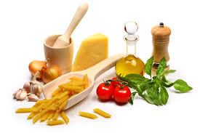




Halal Malaysia Achievement:
Exports
Export Values
Top 5 Export Items
Key Exports Destination
F&B
RM 39 billion in 2015 as compared to
RM24 billion in 2011
Ingredients
Palm oil Derivatives
Source: HDC

Slide 22
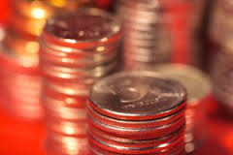
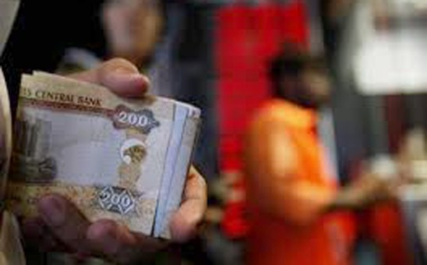
Halal Malaysia Achievement:
Islamic Finance
In 2015, Malaysia issued 53% of global Sukuk issuance.
Malaysia is indeed in a very firm position to offer a credible, convenient and Syariah compliant alternative to conventional financing needs.
This is a key area which we need to continuously build our competencies.

Slide 23
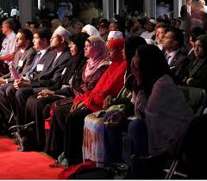
World Halal Week – A Premier Event
7th International Halal Certification Bodies Convention 2016 hosted by JAKIM
54 Halal certification bodies from 32 countries and 4 Halal authorities from OIC member countries
Agreed in the Convention is to have an International Halal Authority Board (IHAB) as an accreditation body.

Slide 24
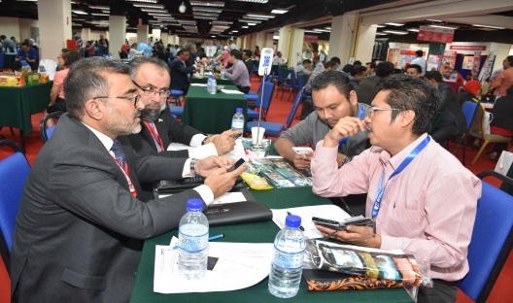
World Halal Week – A Premier Event
13th Malaysia International Halal Showcase (MIHAS) by MATRADE
- Participating countries: 29 countries
- In 2015, MIHAS has generated a total sale of RM1.1 bil
International Sourcing Programme (INSP):
  391 foreign buyers from 40 countries
  More than 600 Malaysia-registered companies
27% higher compared to last year and the preliminary sale recorded was close to RM480 million (8% over the sales recorded last year)

Slide 25
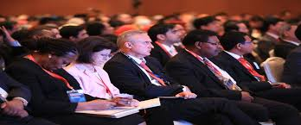
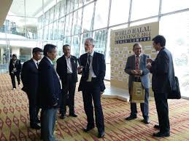
World Halal Week – A Premier Event
9th Edition of World Halal Conference by Halal Industry Development Corp (HDC)
9th edition of Conference continues to attract the best minds in halal related areas to deliberate on pertinent issues impacting global halal industry growth.
More than 1,200 delegates from more than 50 countries are expected to attend

Slide 26

My appreciation to..
This includes not just the Ministry of International Trade and Industry and its agencies MATRADE and HDC, but also the Department of Islamic Development (JAKIM) and each and every one of you here.

Slide 27
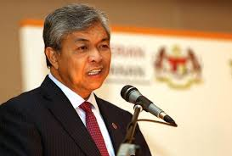
Moving forward :
Malaysia Halal Council (Majlis Halal Malaysia)
A high level committee chaired by Deputy Prime Minister to spearhead the achievement of making Malaysia the Global Halal Hub by 2020
Supported by Halal Industry Development Committee and Certification & Standards Committee
Dato' Seri Dr. Ahmad Zahid Hamidi
Deputy Prime Minister of Malaysia

Slide 28
Thank you

