Slide 1
ITA Product Evoluation

Slide 2
Background
World Trade Organization:
- The government forum managing and liberalizing international trade.
- One role of the WTO has been to negotiate worldwide tariff concessions.
WTO Information Technology Agreement (1996):
- Eliminates import duties on specified products and their parts.
- The Agreement was implemented in 1996 and about 75 countries are signatories, representing approximately 97 per cent of world trade in IT products.
2
© Copyright 2010 Hewlett-Packard Development Company, L.P. The information contained herein is subject to change without notice. Confidentiality label goes here

Slide 3
Principles of the ITA
ITA Signatories agree to eliminate tariffs on specified products either immediately or in stages.
ITA tariff commitments are implemented on a Most Favored Nation basis, so all WTO members benefit even if they are not ITA signatories.
The coverage of the ITA is primarily expressed using HS classification codes.
3
© Copyright 2010 Hewlett-Packard Development Company, L.P. The information contained herein is subject to change without notice. Confidentiality label goes here

Slide 4
Product Evolution and Convergence
Over time, ITA products have evolved and have incorporated new features and functions that make the HS classification uncertain
The product coverage of the ITA is driven by decisions taken on tariff classification by local Customs
With increasing frequency ITA products are not consistently classified by Customs classifiers
4
© Copyright 2010 Hewlett-Packard Development Company, L.P. The information contained herein is subject to change without notice. Confidentiality label goes here

Slide 5
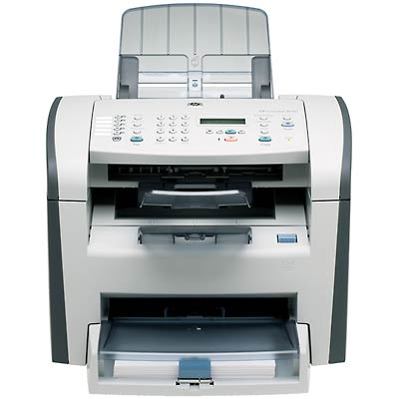
Laser All-in-One Printer
Under the pre-2007 version of the HS, there was no tariff code for all-in-one printers.
The ITA covered the tariff codes for office computer printers, scanners, fax machines and inkjet copiers. However, it did not cover laser based copiers.
Some ITA signatories classified all-in-one
printers within ITA codes, others excluded these products from ITA.
Notes:
Examples of countries that excluded laser all-in-ones from ITA included the European Commission and Switzerland.

Slide 6
Laser All-in-One Printer (Cont.)
Due to the impact on ITA coverage, the classification of laser all-in-one printers has been litigated in certain countries.
The World Customs Organization developed a new code specifically for all-in-one products as part of the 2007 version of the HS. However, it was unable to resolve the proper classification of these products under the pre-2007 version of the tariff code.
Finally, the ITA treatment of laser all-in-ones was addressed in a WTO case brought by the US, Japan and China Taipei.
6
© Copyright 2010 Hewlett-Packard Development Company, L.P. The information contained herein is subject to change without notice. Confidentiality label goes here
Notes:
Note: The WCO reviewed the classification of laser all-in-ones three times, classifying once as a printer (ITA code), once as a copier (non-ITA code), and the last time there was a tie vote.

Slide 7
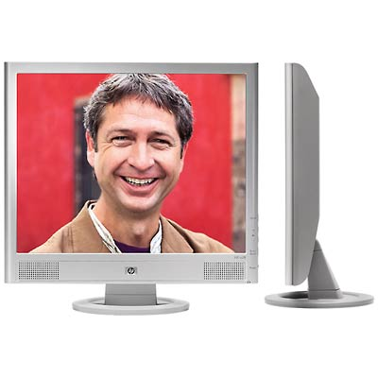
Flat Panel PC Monitors
The ITA covers PC monitors (8528.51), but not televisions (8528.72) or other video monitors (8528.59).
New flat panel monitors produced by computer makers are sometimes classified as PC monitors by local Customs and sometimes as video monitors.
7
© Copyright 2010 Hewlett-Packard Development Company, L.P. The information contained herein is subject to change without notice. Confidentiality label goes here

Slide 8
Flat Panel PC Monitors (Cont.)
Flat panel monitors are currently the subject of numerous disputes in ITA signatory countries.
The WCO has not consistently classified flat panel monitors.
- The ITA treatment of flat panel monitors was also addressed in the same dispute settlement case involving the US, Japan, China Taipei and the European Commission.
8
© Copyright 2010 Hewlett-Packard Development Company, L.P. The information contained herein is subject to change without notice. Confidentiality label goes here
Notes:
We litigated the classification of FPD’s successfully in the Netherlands.
The classification of HP FPD’s has been before the WCO recently. Two monitors with DVI were classified as PC monitors. A third HP monitor with HDMI and speakers will be reconsidered in September, after first being classified as video monitors last year.

Slide 9
Negotiation to Expand the Product Coverage of ITA
ITA signatories are currently considering proposals from global industry to expand the coverage of the ITA. The objective is agree on an ITA II by the end of 2013.
While a WTO dispute panel has addressed the ITA treatment of flat panel displays and laser all-in-ones for certain countries, these issues are still contested in other ITA jurisdictions.
The negotiation to expand the ITA is an opportunity to clarify and harmonize the coverage of the Agreement.
9
© Copyright 2010 Hewlett-Packard Development Company, L.P. The information contained herein is subject to change without notice. Confidentiality label goes here

Slide 10
Thank you

