Slide 1
APEC Workshop on the Advancement of Trade in IT Products by Shaifubahrim Saleh CEO/President of PIKOM June, 2013

Slide 2
About PIKOM
Membership Growth
New Building 2013
To Champion and Realise the Digital Opportunity

Slide 3
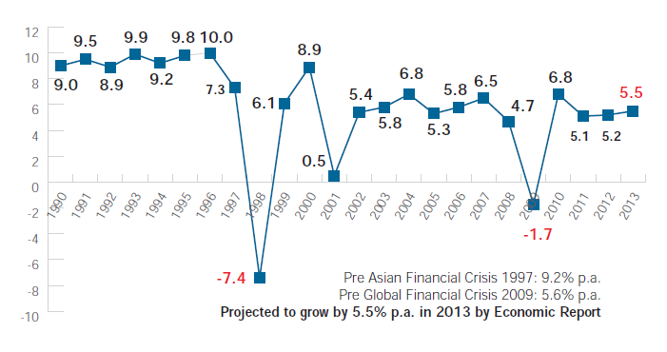
Economic Outlook & Challenges
Positive Economic Outlook
Economic transformation programmes and mega projects
Stronger and stable currency
Stable overnight policies
Sustained private and public consumption expenditure
Expanding trade share with Asia / China
Key Economic Challenges
FDI aversion risks
Slack in macro project implementation
Dampening public investment
Fluctuating commodity prices at global
Capital flight due to volatile foreign exchange
Overdependence on foreign workers
Inadequacy of quality work force
Post GE13 stability

Slide 4
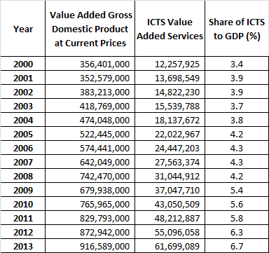
Share of ICTS to GDP
Share of ICTS to GDP almost doubled from 3.4% in 2000 to 6.7% by 2010

Slide 5
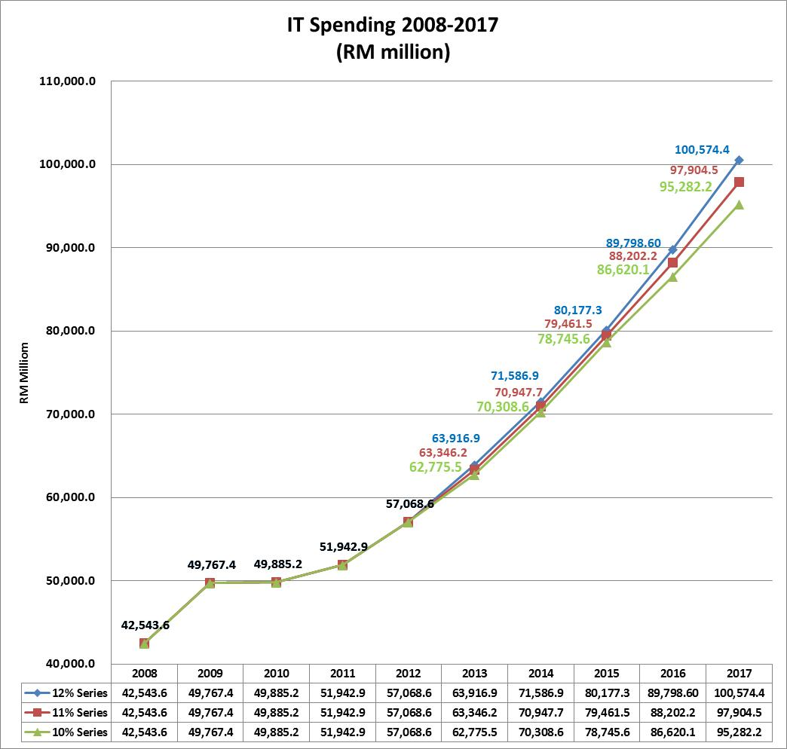
ICT Spending Projection: 2008-2017
ICT SPENDING in RM Million
Source: Digital Planet and PIKOM estimates

Slide 6
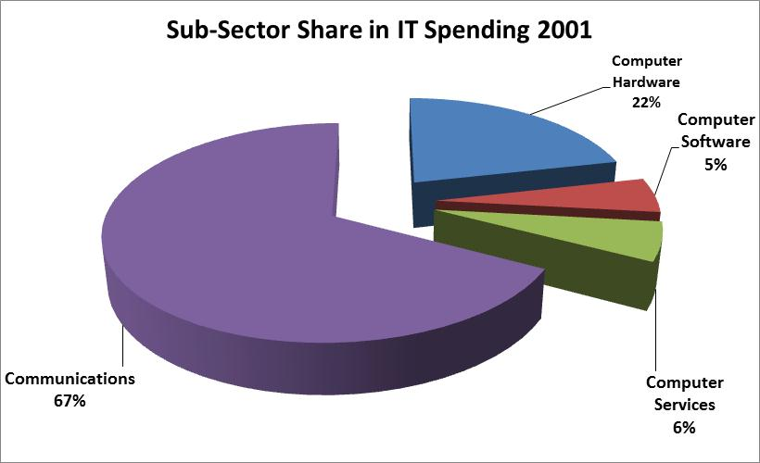
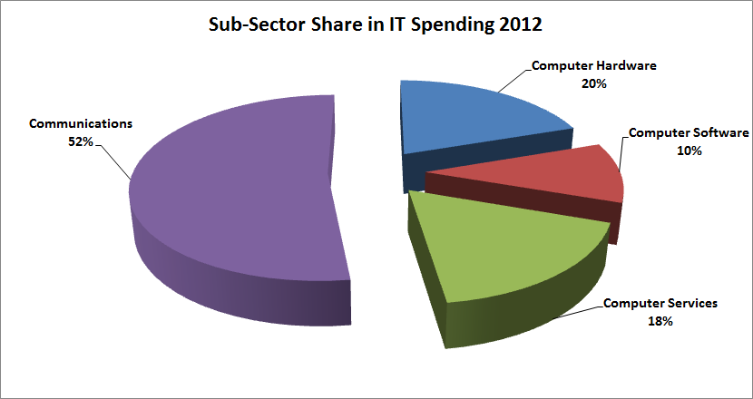
Structural Changes in ICT Spending 2001 and 2012

Slide 7
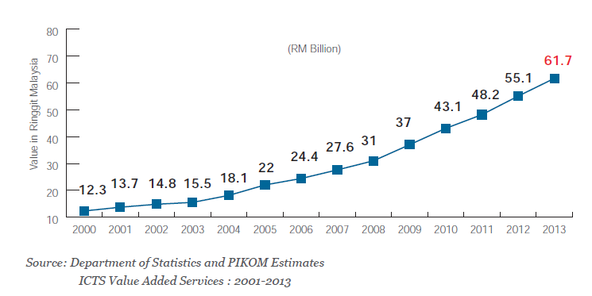
ICT Services Outlook & Challenges
ICT Potential
Cloud computing - reduced infrastructure cost and maintenances hassle free viable for SMEs
Big data analytics – Enhances BI
Mobile device usage – increasingly promotes consumerization of IT changing work culture and work force life style e.g. teleworking / BYOD
Advent of social business – social technologies enables new networks of customers, partners and employers, thus creating new opportunities for business and innovation
ICT Challenges
Declining supply of graduates
Incompatible graduates quality meeting industry demands
Weak quality and process competency and standards
Lingering challenges in R&D, patenting and commercialization culture

Slide 8
Driving forces of future ICT
Plethora of New Opportunities

Slide 9
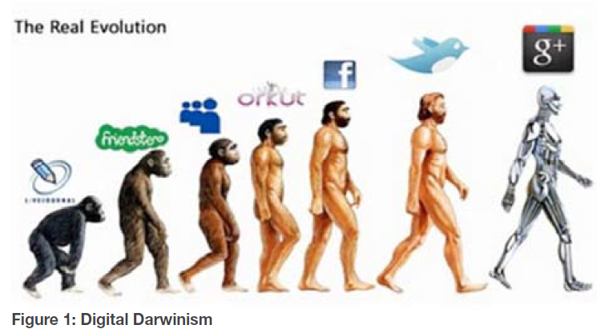
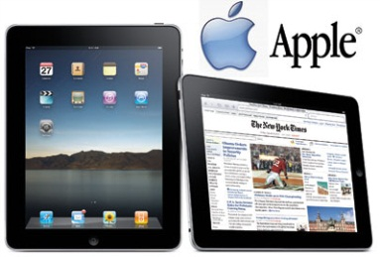
Nexus of Forces and Disruptive Innovation
disruptive Innovation is one that “helps create a new market and value, and eventually goes on to disrupt an existing entire market and value network”

Slide 10
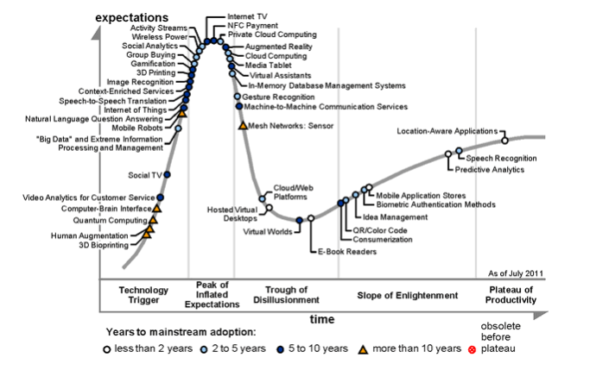
Gartner Technology Hype

Slide 11
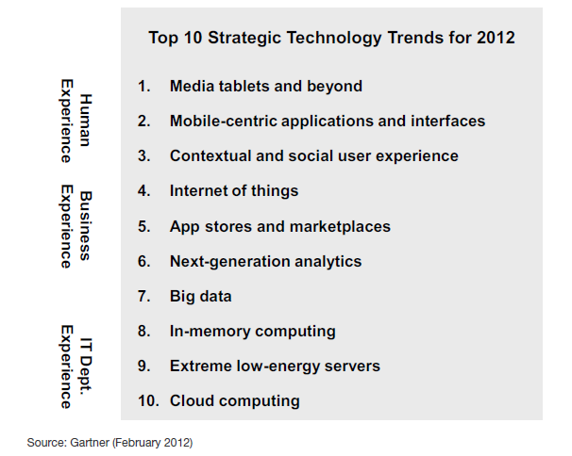

Slide 12
ICT Roadmap 2012: ICT Policy Direction
ICT Roadmap 2012 charts the emerging ICTS areas having great socio-economic potentials
Notes:
This chapter is prepared by Dr Amiruddin of MOSTI. Essentially the paper describes how the ICT Roadmap 2012 has evolved from Technology Roadmap to ICT Roadmap 2008. The roadmap preparation also takes into account of ICT mega-trends. The ICT Roadmap has 6 Technology Focus Areas (TFA) namely e-services, ubiquitous connectivity, security & platforms, wireless intelligence, big data analytics and cloud computing.

Slide 13
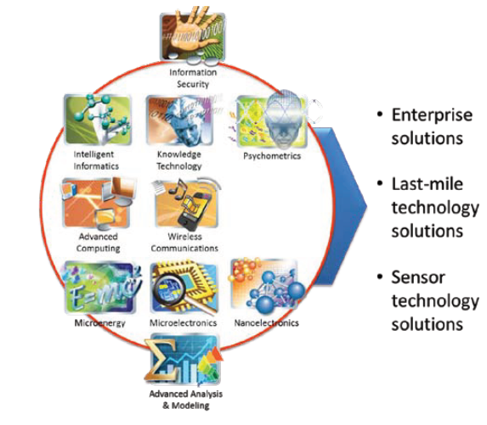
MIMOS R&D Thrusts: Endogenous Growth
Buy Some, Make Some and
Produce More
Best Practices to Next Practices
MIMOS R&D provides long-term strategy for brewing indigenous ICT products and services

Slide 14
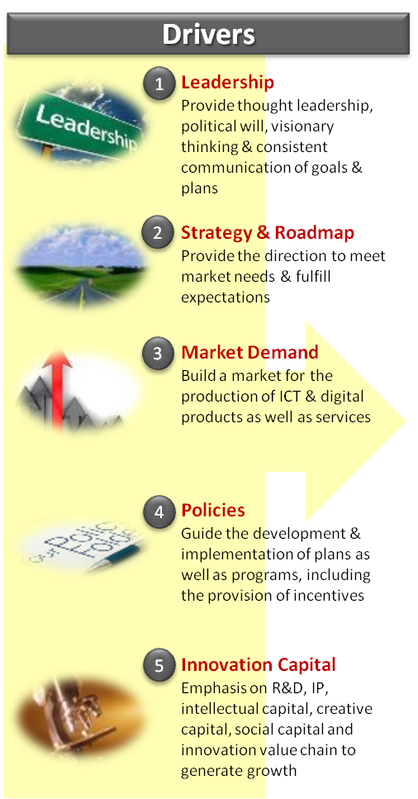
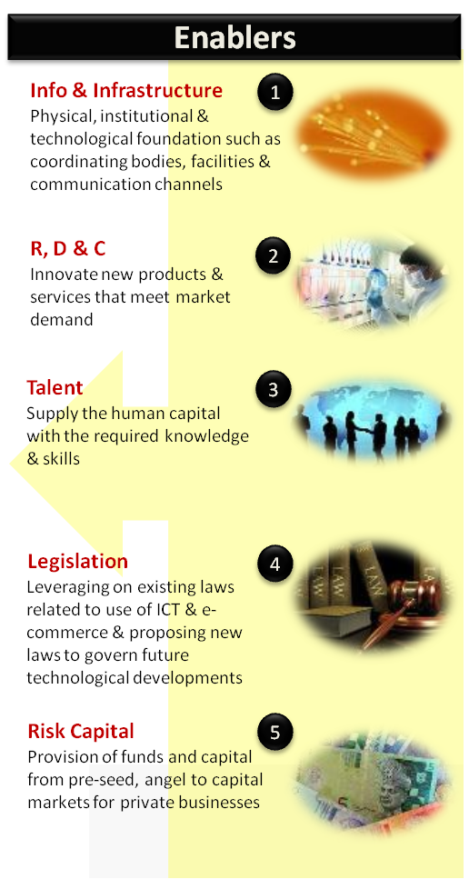
Digital Malaysia Ecosystem: Requiring development dimension and approach
Dimensions
1
Economic
Increase GNI contribution, wealth generation, market capitalisation, productivity & high value jobs
2
Social
Infusion of technology to uplift quality of life
3
Governance
Enable governing entities a greater outreach to constituents, transparency & democratise instruments of command & control
4
Technological
Spur innovation across all sectors & IP valuation
5
Environmental
Infusion of technology to minimise damage to the environment

Slide 15
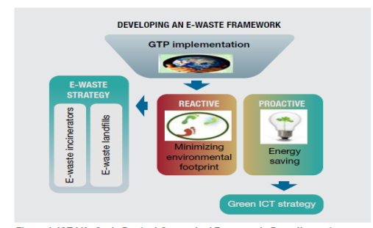
Green ICT / e-Waste Disposal: Environment sustainability
Green ICT, Smart Business
ICT could save 7.8 billion metric tons of carbon dioxide equivalent by 2020, representing 15% of global emissions;
Malaysian Green Technology Policy to reduce its carbon emission by 40% by 2020;
Green governance structure, delivering energy efficient ICT, data centre efficiency and virtualization strategy are of paramount concerns of future smart businesses
ICT key to carbon
reduction

Slide 16
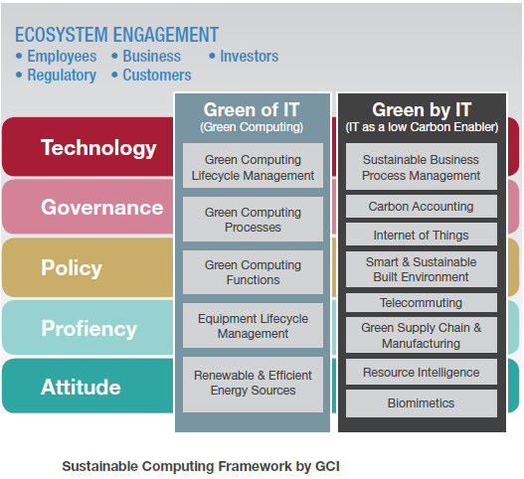
Green ICT Jobs: Next Generation ICT Job
Green Jobs for a Low Carbon Economy: Next-Gen Green collar IT Professionals
Generating green job is imperative as the nation moves towards a low carbon economy. It helps to protect and restore ecosystems and biodiversity, reduce energy, materials and water consumption through high efficiency and avoidance strategies. Such professionals need to be Certified.

Slide 17
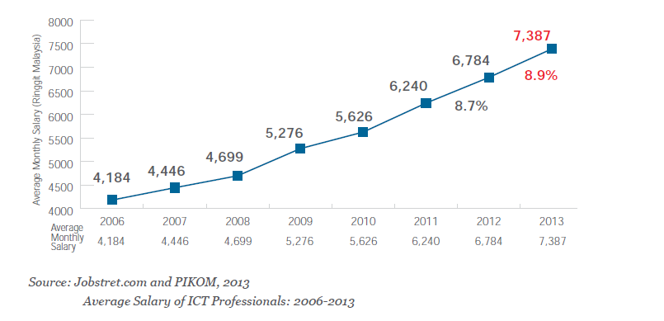
ICT Salary Trend: Growing steadily

Slide 18
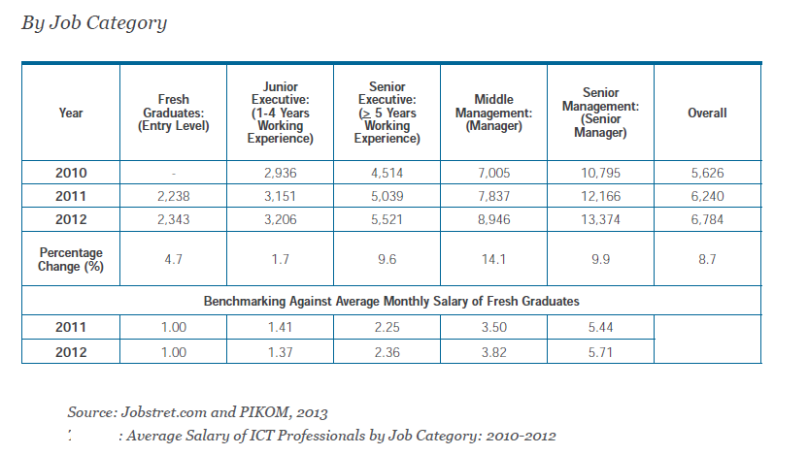
Widening Disparity by Job Category

Slide 19
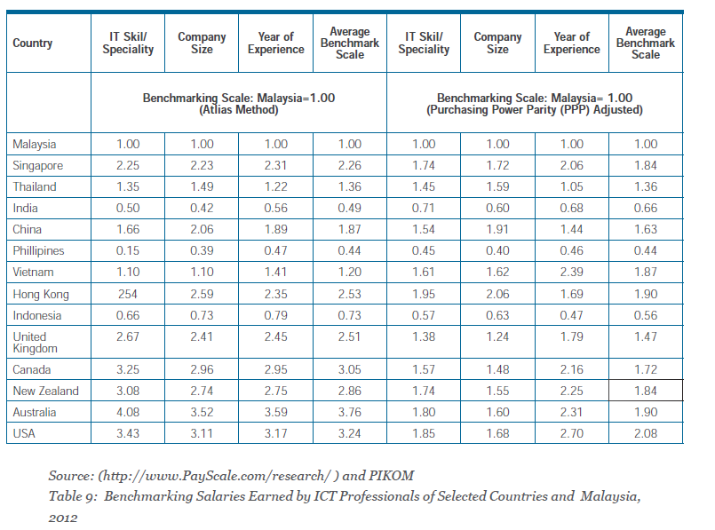
Regional Disparity Atlas and Purchasing Power Parity (PPP) Adjusted

Slide 20
Key ICT Drivers & Enablers for SME
Ubiquitous data centre: The data center is everywhere
Managing technology: one can use and manage technology
Multi-facet devices: New way of providing computing applications and services
Cloud computing merits: No longer need heavy investment on resources
Internet driven: Internet connected applications, tools, and services in the cloud
Consumerization and democratization of ICT: Enabling each of us to become our own one-person ICT team. Need an email account? Simply go to Yahoo or Hotmail, sign up, and you are up and running instantly.
Mitigated proprietary arrangements: No longer has a monopoly on technology or a proprietary operation.
Business cost reduction: Line of business users can build their own applications cheaper and faster, at a much lower cost;
Information and knowledge sharing: More sharable information available in the market, business and policy space
Technology savvy Z generation: Demanding new work culture and practices like buy your own device (BYOD), tele-working, work from home et cetera.

Slide 21
THANK YOU
1106 & 1107, Block B, Phileo Damansara II, No. 15, Jalan 16/11 , 46350 Petaling Jaya Selangor Darul Ehsan, MALAYSIA.
T : +603-7955 2922
F : +603-7955 2933
E : info@pikom.org.my
W : www.pikom.my

