Slide 1

Expanding the Information
Technology Agreement
APEC Secretariat, Policy Support Unit
20-21 June 2013
Presented by
Carlos Kuriyama
Senior Analyst, Policy Support Unit
Advancing Free Trade for Asia-Pacific Prosperity
©2012 APEC Secretariat

Slide 2
APEC’s momentum to support ITA expansion
• ITA was initially signed on December 1996 and entered into force on 1 April 1997.
• Expansion is important. For example, some products are obsolete and new IT products are becoming available.
• APEC could take a leadership role in the expansion talks. APEC accounts for nearly 80 percent of the world trade of ITA products.
• APEC could be the catalyzer to reach an agreement on the ITA expansion at WTO.
• The ITA expansion would be a key deliverable for the WTO Ministerial Conference in Bali, December 2013.

Slide 3
Market size of current ITA products
World Trade of ITA products tripled from 1996 to 2011, but
APEC Trade of ITA products almost quadrupled…
NOTE: Trade values are higher. Neither most of the “ex-out” HS subheadings, nor the 13 product descriptions in ITA not associated with any HS code (Attachment B)are included in the table.

Slide 4
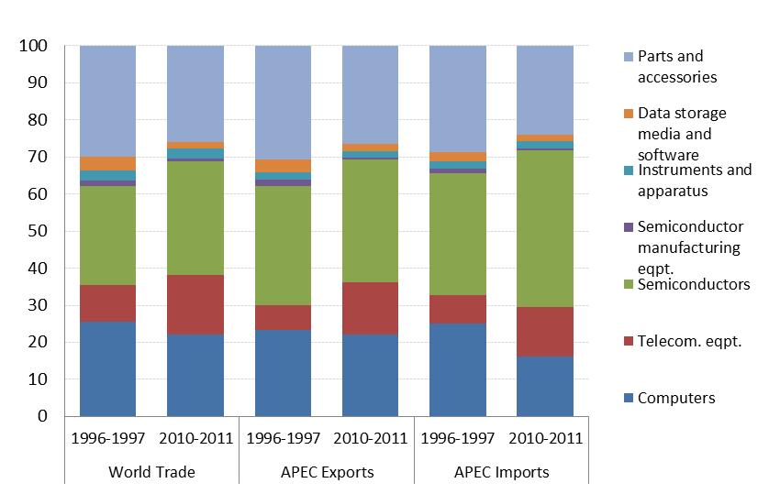
Types of products within ITA
Most of the ITA products’ trade comes from semiconductors; parts and accessories and computers. Semiconductors and telecommunications equipment are increasing their share
Source: UN COMTRADE; WITS

Slide 5
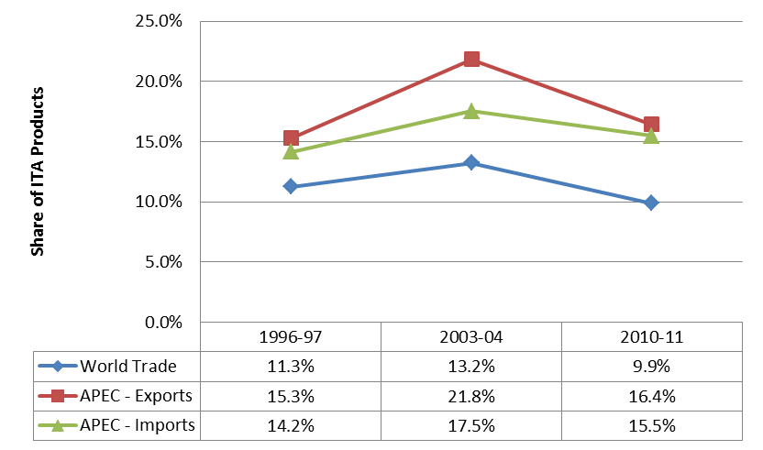
Share of ITA products in trade flows is declining…
ITA products’ trade decelerated in recent years and their share in world trade and APEC trade declined.

Slide 6
Declining growth rates…
During the period 1996-2011, ITA products’ trade decelerated sharply…
Growth rates in the 2nd half < Growth rates in the 1st half

Slide 7
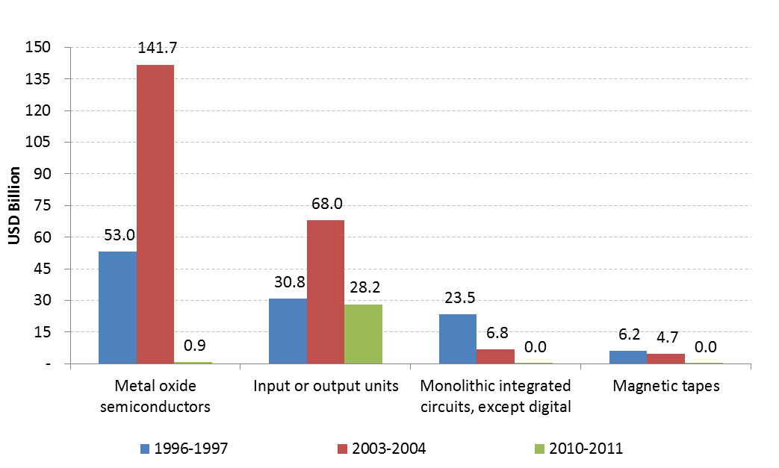
Obsolescence of some ITA products
World Trade of selected ITA products:

Slide 8
Obsolescence of some ITA products
Examples of ITA products with declining trade:
Word-processing machines
Accounting machines
Electronic calculators
Teleprinters
Magnetic tapes
Analogue or hybrid computers
Input or output units
Facsimile machines
Metal oxide semiconductors
Direct electrostatic photocopiers
A subgroup of 32 HS ITA subheadings with declining trade was selected:
World Trade of 32 HS ITA subhadings | USD billion | Share in World Trade
Average 2003-04 | 287.6 | 27.9
Average 2010-11 | 33.7 | 2.3
Trade declined between 2003-04 and 2010-11 in 88.3 percent!

Slide 9
Goods and services out of ITA
Among products not included in ITA:
DVD, VCD, MP3, MP4 players
GPS devices
Multifunctional devices that print, copy and scan
Scientific, medical instruments with IT applications: MRI equipment, compound optical microscopes, etc.
Consumer electronics. For example, TV monitors.
Services trade in IT sector is increasing and medium of transactions is changing from goods to services, but services not included in ITA.

Slide 10
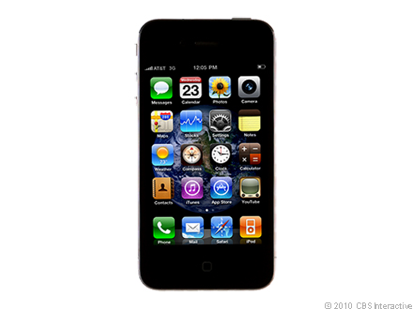
Growing interdependence of Global Production Chains for ITA products
Example: iPhone, which is assembled in China
DRAM memory, applications processor from Korea
Touchscreen and camera from Chinese Taipei
Baseband, power management and transceiver from Germany
Audio codec, memory and touchscreen controller from USA
Flash memory and display module from Japan

Slide 11
Expansion of ITA membership
• Increasing ITA membership will allow covered products to have duty-free access to a much larger market.
• Five APEC members are not part of ITA yet (Brunei Darussalam; Chile; Mexico; PNG and Russia). Russia working on ITA Schedule of Commitments now.
• Other important non-APEC economies not part of ITA are Argentina, Brazil, South Africa and Tunisia.
• The aforementioned economies (except Russia) represent a market of 438 million inhabitants. Tariff of ITA products range from 0 percent to 30 percent in these economies.

Slide 12
Proposals to expand ITA product coverage
Current ITA Products and Potential ITA Products’ Trade in USD billion (average 2010-11)
Source: UN COMTRADE; WITS; ECIPE and USITC

Slide 13
Final remarks
In 1996, APEC was instrumental in the negotiations that originated the ITA. Now, APEC can play similar role to expand it.
An expanded ITA will assist to strengthen the multilateral system.
APEC can provide the momentum and assist the multilateral talks to achieve an expanded ITA and facilitate a key deliverable in the WTO Ministerial Conference at Bali in December 2013
Rapid technological changes, obsolescence of IT products and growing IT interdependence of global production chains are compelling reasons to expand ITA.
Better market access for IT products is critical to foster innovation, spur productivity and boost economic growth.

Slide 14
Further Information
APEC Website - www.apec.org
Policy Support Unit - www.apec.org/About-Us/Policy-Support-Unit.aspx
APEC Secretariat, Policy Support Unit
35 Heng Mui Keng Terrace
Singapore 119616
Telephone: (65) 6891 9400
Fax: (65) 6891 9419
Email: PSUgroup@apec.org

Slide 15
Expanding the Information
Technology Agreement
APEC Secretariat, Policy Support Unit
20-21 June 2013
Presented by
Carlos Kuriyama
Senior Analyst, Policy Support Unit
Advancing Free Trade for Asia-Pacific Prosperity
©2012 APEC Secretariat

