Slide 1
Introduction to Remanufacturing
By
Professor Dr. Awaluddin Mohamed Shaharoun, Dean, Universiti Teknologi Malaysia (UTM) Razak School of Engineering & Advanced Technology.

Slide 2
OBJECTIVES
To define and identify the remanufacturing activities in Malaysia.
Enhance understanding on the scope and definition of remanufactured goods
Overview of remanufacturing industries, existing environment on Remanufacturing activities in Malaysia and the Asia Pacific.

Slide 3
REMANUFACTURING
THE CONCEPT
Remanufacturing is an industrial process whereby used/broken-down products (or components) – referred to as ‘‘cores’’ – are restored to useful life. Remanufacturing means that a product is reprocessed or upgraded in an industrial process (Ostlin, et al., 2009).

Slide 4
THE DEFINITION REMANUFACTURING
An industrial process that transforms end of life (EOL) product into a product with as good as new condition (Matsumoto, 2009; Seitz, 2007).
The process of bringing a used product to like-new condition through replacing and rebuilding component parts (Haynsworth and Lyons, 1987)
Remanufacturing is the process of restoring a non-functional, discarded, or trade-in products (cores) to like-new performance (Lund and Hauser, 2008)
Remanufacturing is a process of bringing used products to like-new functional state with warranty to match (Ijomah, et al., 1998)

Slide 5
REMANUFACTURING
PRODUCT PROFILE
Look-like new; Same condition as brand new product OEM product
Same technical performance with comparable brand new OEM product
(could be more due to upgrading)
Same warranty period as given to a comparable brand new OEM product
Same expected life-span as brand new/OEM product
Lower in Price (45% -65% of the price of comparable new OEM product)

Slide 6
REMANUFACTURING OPERATIONAL DEFINITION
Input Profiles | Process/Activities Involve | Output Profiles
Used Products/Broken-down Products/ Components . [Cores] | Disassembled Checking/Inspecting Cleaning/Drying Repairing/Rebuilt/Replacing/ Repainting Reassembled Testing | Look-Like a comparable brand new product OEM product At least same performance as a comparable brand new OEM product Same lifespan with a comparable brand new OEM product (subject to maintenance) Have warranty (could be a same period and coverage as given to comparable brand new OEM product) 40%-65% lower than a price of comparable brand new OEM product

Slide 7
EXPLORING RE-MANUFACTURING ACTIVITIES IN MALAYSIA
Remanufacturing vs. Other Activities
Recycling
Processing used material into new products
Repairing
Correction of specified faults
Refurbishing
A used product, cleaned up, tested, repackaged and made available for re-sale
Reconditioning
A used product that is cleaned up and tested extensively with possible repair, re-sale at a satisfactory working condition
Remanufacturing
Returning a used product to a least OEM original performance specification

Slide 8
REMANUFACTURING RECONDITIONING REPAIRING
Remanufacturing: The process of returning a used product to at least OEM original performance specification from customers’ perspective and giving the resultant product a warranty that is at least equal to that of a new manufactured equivalent.
Reconditioning: The process of returning a used product to a satisfactory working condition that may be inferior to the original specification. Generally, the resultant product has a warranty that is less than that of a newly manufactured equivalent. The warranty applies to all major wearing parts.
Repairing: Repairing is simply the correction of specified faults in a product. When repaired products have warranties, they are less than those of newly manufactured equivalents. Also, the warranty may not cover whole product but only the component that has been replaced.

Slide 9
Remanufacturing: Definition and Process (TOR 1)
Proposed Definition
Remanufacturing is an industrial process whereby used product or components are restored to at least OEM’s specification, performance and warranty
The Process
Used
product
Disassembled
Inspecting/
Checking
Cleaning/
Drying/
Repairing/Rebuilt
Replacing/
Repainting
Reassembled &
Testing
Like –New Product

Slide 10
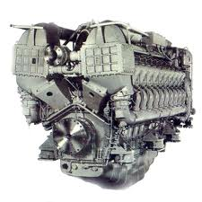
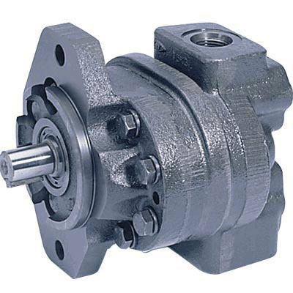
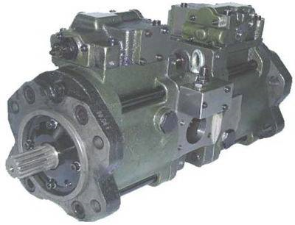
Example of Malaysian Remanufacturing Products
Power & Distribution Transformer
(Malaysia Transformer Manufacturing Sdn Bhd)
Hydraulic Pump, Hydraulic Motor (Hitachi Construction Machinery (M) Sdn Bhd
MTU Diesel Engines
(Motor Teknologi Industri Sdn Bhd)

Slide 11
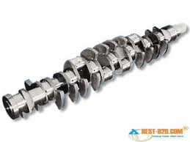
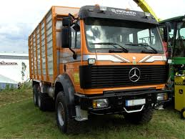
Remanufacturing: Parts, Components, Whole Product

Slide 12
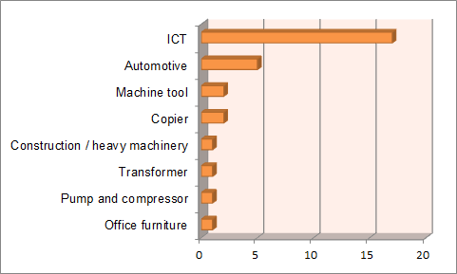
Malaysian Remanufacturing Products by Sector
Source: MITI, MIDA, FMM, internet
* number of companies
** Based on companies’ claim

Slide 13
The Potential and Impacts of Remanufacturing in Malaysia (TOR 3)

Slide 14
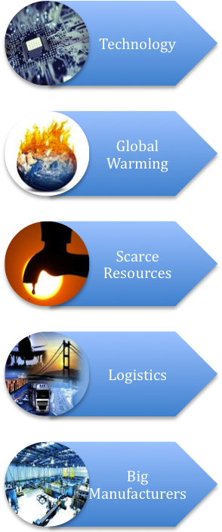
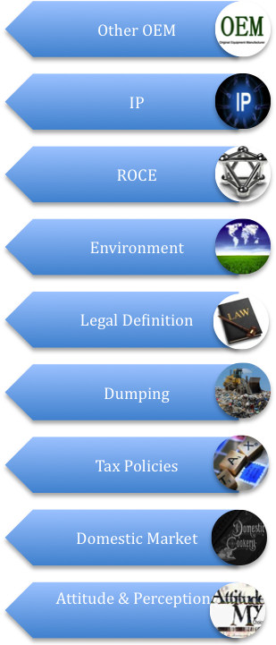
The Potential and Impacts of Remanufacturing in Malaysia
GROWTH OF REMAN
PUSHING
FORCES
RESTRAINING
FORCES
Lewin Model

Slide 15
Profile of Selected Remanufacturing: Product & Process
Source: Interview

Slide 16
Profile of Selected Remanufacturing: Product & Process
Source: Interview

Slide 17
Profile of Selected Remanufacturing: Product & Process
Source: Interview

Slide 18
CHINA
Has commissioned a remanufacturing project: engine, transmission, steering gear, starter and generator.
Remanufacturing is listed in the National Long and Medium Term Program of Science Technology Development Planning as a key technology in manufacturing field.
The government promotes the development of remanufacturing industry by facilitating the establishment of production system and consumption system.
Manufacturing joint venture between Guangxi Yuchai Machinery Company Limited (GYMCL) and Caterpillar (China) Investment Co., Ltd
➔ Yuchai Remanufacturing Services (Suzhou) Co., Ltd.
Held 49%-51% by Caterpillar China and GYMCL, incorporated in April 2010 in Suzhou, Jiangsu Province to provide remanufacturing services for and relate to GYMCL's diesel engines and components and certain Caterpillar diesel engines and components.

Slide 19
SINGAPORE
In May 2011, Caterpillar announced the opening of new remanufacturing facilities in Singapore.
Served as the regional source for remanufactured major components for large off-highway trucks and other mining equipment, including engines, transmissions, final drives and torque converters.
In less than a year, Caterpillar has remanufactured more than two million pounds of end-of-life iron, using between 85 and 90 percent less energy than if those same components had been made new.
In May 2012, Singapore established the Advanced Remanufacturing & Technology Centre (ARTC).
By mid quarter of 2012, Singapore announces the presence of Boeing, Roll-Royce, Siemens Industry Software, ABB, FUCHS Lubricants and Carl Zeiss

Slide 20
INDONESIA
Komatsu Reman Indonesia
Established in January 18, 2007, serves as the Components Remanufacturing Plant as well as Global Reman Products Supplier of Komatsu as the leading of construction and mining machinery.
99.875 % owned by Komatsu Indonesia and 0.125 % owned by Komatsu Under Carriage Indonesia.
Remanufacturing of Complete engine, Power line components, Piston pumps and motor

Slide 21
SELECTED PRACTITIONER’S ON REMANUFACTURING WORLDWIDE
Company | Definition
United States International Trade Commission (USITC) | Comprises of parts that have been obtained from the disassembly of used goods; and have been processed, cleaned, inspected, and tested to the extent necessary to ensure they have been restored to original working condition or better; and for which the remanufacturer has issued a warranty.
Cummins (Korea) | Engine core processing with component remanufacturing for use in local rebuild (e.g. typically blocks, cranks, cams, rods, and miscellaneous parts)
Yuchai (China) | Remanufacturing engineering is to develop a progress to return used core to new condition. Some engineering specification should be changed on remanufacturing print. Validation will only be necessary to be applied to those changed specification.
Solar Turbines (US) | The process of returning to end of life to its original condition, same as new condition or better manufacturing environment in accordance to engineering specification, performance validation testing, manufacturing quality systems and OEM’s warranty.
Komatsu (Japan) | Quality and performance guaranteed to be the same level as those for new components, lower cost for remanufacturing components, reduced idle time for machines through sufficient inventory.
Shin-Etsu Denso (Japan) | Disassembled, cleaned, replaced, tested, and mostly warranted

Slide 22
Recommendation: Potential Remanufactured Products
Source: Whitehouse, 2012

Slide 23
Conclusions
Relatively slow growth industry in Malaysia
Eco-system
Product Criteria & Possible Potential Areas
Government Roles

