Slide 1
POLICY ON STANDARDS AND THE WAY FORWARD

Slide 2
Standards will Improve the quality of goods and services
Case for Change
Sub standard products within domestic market
Ensure quality products which comply to safety and environmental regulations
Low global market recognition
Develop a Brand Malaysia to increase exported
Inefficient enforcement mechanism
Establish framework to enforce compliance and consumer protection
Where are we now and where do we go from here:
Challenges and way forward

Slide 3
Department of Standards Malaysia
Ministry of Science, Technology and Innovation (MOSTI)
National Standards Body
National Accreditation Body
Governed by Standards of Malaysia Act 1996

Slide 4
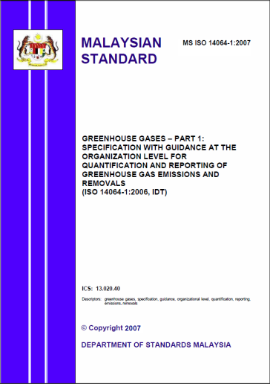
Functions
Develop and promote
Malaysian Standards (MS)
Accredit organisations engaged in testing, calibration, inspection and certification

Slide 5
Functions (cont.)
Skip to content
National Mirror Committee
on WTO TBT
(Technical Barriers to Trade)
Provide support to Government on related trade policies,
Free Trade Agreement (FTA) negotiations

Slide 6
The main functions of STANDARDS MALAYSIA are:
STANDARDS
ACCREDITATION
Implement policies and strategies for national standardisation;
Recommend Malaysian Standards for approval;
Promote the usage of Malaysian and international standards;
Represent Malaysia in regional and international standardisation activities; and
Promote co-operation in standardisation activities within the country as well as with regional and international organisations.
Accredit organisations engaged in conformity assessment activities: testing, calibration, inspection and certification of products and systems;
Maintain a register of accredited organisations and their marks of conformity;
Represent Malaysia in international and regional accreditation activities; and
Facilitate international and regional recognition of accredited organisations and certificates.

Slide 7
Standards of Malaysia Act 1996
Mandates the Department of Standards Malaysia to develop national standards and accredit conformity assessment bodies
Gives power to the Minister to declare any documents developed under this act as national standards (Malaysian Standards-MS)

Slide 8
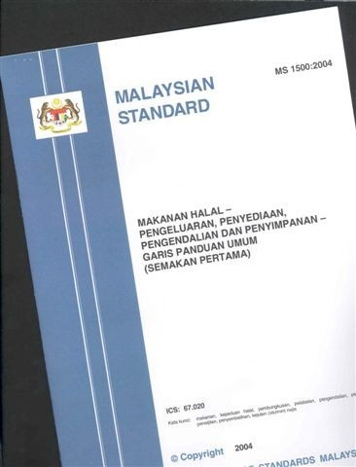
Standards of Malaysia Act 1996 – Key Provision
Document approved by a recognised body, that provides, for common and repeated use, rules, guidelines, or characteristics for products or related processes and production methods, with which compliance is not mandatory; and which may also include or deal exclusively with terminology, symbols, packaging, marking or labelling requirements as they apply to a product, process or production methods

Slide 9
Principles of Malaysian Standards Development
Governed by:
ISO/IEC Guide 59: 1994 – Code of Good Practice for Standardisation
Annex 3 to the WTO/TBT Agreement – Code of Good Practice for the Preparation, Adoption and Application of Standards
Annex 3 to the WTO/TBT
Where international standards exist or their completion is imminent, the standardizing body shall use them, or the relevant parts of them, as a basis for the standards it develops, except where such international standards… would be ineffective or inappropriate..because of an insufficient level of protection or fundamental climatic or geographical factors or fundamental technological problems.
9

Slide 10
INDUSTRY STANDARDS COMMITTEES (ISC)
ISC A Agriculture
ISC B Chemicals and Materials
ISC D Building, Construction and Civil Engineering
ISC E Generation, Transmission and Distribution of Energy
ISC F Mechanical Engineering
ISC G Information Technology, Communication and Multimedia
ISC H Petroleum and Gas
ISC I Halal Standards
ISC J Plastics and Plastic Products
ISC K Packaging and Logistics
ISC L Road Vehicles
ISC M Fire Safety and Prevention
ISC N Rubber and Rubber Products
ISC O Organisational Management
ISC P Metallic Materials and Semi-finished Products
ISC Q Textiles and Apparels
ISC R Medical Devices and Facilities for Healthcare
ISC S Electrical and Electronics Equipments and Accessories
ISC T Tourism, Exhibition & Hospitality Services
ISC U Food and Food Products
ISC W Occupational Safety and Health
ISC Y Quality Management and Quality Assurance
ISC Z Environmental Management
ISC C Consumer Interests

Slide 11
Malaysian Standards Status as of 30 November 2011

Slide 12
IMPLEMENTATION OF
MALAYSIAN STANDARDS
Voluntary adoption by industry or trade organisations for production and commerce
Third party certification to provide independent assurance to users of products and services
Adoption by regulatory agencies for meeting specific regulatory objectives
12
Notes:
12

Slide 13
Mandatory Standards as of 30 November 2011

Slide 14
MANDATORY STANDARDS
Confusion among Government agencies, industries on the enforcement of standards in technical regulations.
STANDARDS MALAYSIA – develops standards
Regulators – enforce standards

Slide 15
Engaging Stakeholders

Slide 16
Stakeholders
Government
a. Policy makers
b. Regulators
Industry and trade associations
Academia
4. Professional bodies
5. Consumer associations
Annual work programmes to engage all these groups
16

Slide 17
Examples of Partnerships
Institution of Engineers Malaysia
Revision of standards for the construction industry
Energy Commission
Adoption and promotion of updated standards on electrical installations
3. Malaysian Palm Oil Board
Development & promotion of Standards for environmental protection, global warming (GHG) at national and international levels
4. Malaysian Timber Industry Board
Development & promotion of standards on timber and products at national and international levels
Malaysian Plastics Manufacturers Association
Development & promotion of standards for plastics products

Slide 18
Challenges & way forward

Slide 19
Challenges
Lack of awareness on standards development process, benefits of standards, especially amongst SMEs
Perception that standards development is the responsibility of the Government
Notes:
19
19

Slide 20
Way forward
Constant and multiple channels of communication with stakeholders to establish partnerships
- Regular dialogues and promotions
- Identify partners & areas of interest based on
needs
Staying relevant to stakeholders’ needs
- Conducting periodic studies on standardisation
needs
- Timely delivery of standards needed
Notes:
20

Slide 21
Way forward
3. Amendment of the Standards of Malaysia Act 1996
a) appointment of any organisation in Malaysia to develop standards
- faster delivery of MS
b) cooperation with relevant agencies to facilitate the development of technical regulations
- better implementation of mandatory standards
- adherence to provisions to WTO TBT Agreement
Notes:
21

Slide 22
Amendments to the Standards of Malaysia Act 1996 (Act 549)
Standards of Malaysia Act 1996 (Act 549)
Section 10 Duties and function of the Director-General in subsection (2) (ii) (a)
appoint, in accordance with the criteria approved by the Council, any organization in Malaysia to develop standards and to co-ordinate Malaysian representation in international standardization activities
Amendments passed by the Dewan Rakyat on 1st December 2011. Pending debate/approval in Dewan Negara on 22nd December 2011.

Slide 23
Intro SRI-ISL

Slide 24
Standards will Improve the quality of goods and services
Case for Change
Sub standard products within domestic market
Ensure quality products which comply to safety and environmental regulations
Low global market recognition
Develop a Brand Malaysia to increase exported
Inefficient enforcement mechanism
Establish framework to enforce compliance and consumer protection
A generic toolkit that can be used by all sectors for the adoption of standards
Key Focus Areas
1
Adoption of International Standards
FOCUS
Identifying market segments requiring adoption of standards to improve quality of products and services.
FOCUS
Leverage and monetize indigenous Malaysian products.
Leverage on Malaysian Standards towards international recognition.
Uplift indigenous standards to meet global demands.
2
Internationalize Malaysian Standards
3
Effective governance structure
FOCUS
Establish framework to enforce compliance and consumer protection.
Framework for Standards
Adopt International Standards
Identify
Adopt
Certify
High Quality Products and Services of International Standard
Develop Malaysian Standards and internationalise Standards
Develop
Certify
Promote
Internationalise
Malaysia Standards as the benchmark
Promote Malaysian Standard Internationally

Slide 25
Standards
Attention Required
Monitor
Lead Minister
Datuk Seri Dr. Maximus Johnity Ongkili
Key involved parties
Ministry of Science, Technology and Innovation (MOSTI)
Ministry of International Trade and Industry (MITI)
Ministry of Agriculture
Ministry of Energy, Green Technology and Water (KeTTHA)
Ministry of Health
Ministry of Work
Economic Planning Unit (EPU)
Majlis Keselamatan Negara, Jabatan Perdana Menteri
SIRIM Berhad
Department of Standards Malaysia (STANDARDS MALAYSIA)
Cybersecurity Malaysia
Halal Industry Development Corporation (HDC)
Jabatan Kemajuan Islam Malaysia (JAKIM)
Construction Industry Development Board (CIDB)
Malaysian Agricultural Research and Development Institute (MARDI)
Malaysian Communications and Multimedia Commission (MCMC)
Inadequate capacity due to poor production standards
Absence of effective governance structure
Inadequate compliance mechanism
No control of Sub-standard products entering Malaysian market
Inability to penetrate specific markets
Improve the process and timeline for development of standards
Establish compliance mechanism for enforcing standards
Improves standards of Malaysian goods and services, allowing Malaysian firms to improve access to International Markets
Key Issues
Key Recommendations

Slide 26
Key Areas of Improvement
To Reduce Time taken for the Development of Standards
To review and impose specific timelines for each stage of Standards Development
To allow appointment of multiple Standards Development Agencies (SDAs) by expediting the tabling of amended Standard Malaysia Act 1996 (Act 549).
1
2

Slide 27
Timelines: Standards Development Acceleration
1
Results of Minilab (Nov 2011) are:
Standards Development Timeline Acceleration for Pilot Tests
Adoption:
1 Year
Indigenous:
3 Year
Adoption:
½ - ¾ Year
Indigenous:
1 – 1½ Years
25-50% Reduction
50-66% Reduction
SC Action:
Endorsement of timelines by the Steering Committee

Slide 28
Impact
Increase Malaysia’s Speed to Market of Products, thus increasing Malaysia’s Competitiveness
Exhibit Malaysia’s seriousness of Standards Compliance, this increasing FDI’s confidence

