Slide 1
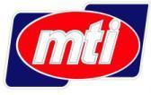
Motor Teknologi & Industri Sdn Bhd
(626311-M)
A Member Of 3Q Berhad
REMANUFACTURER OF ENGINE & ENGINE COMPONENTS
www.mti-reman.com

Slide 2
3Q BERHAD BUSINESS AREAS
ENERGY | MRO | ASSET MANAGEMENT | REMANUFACTURING
Energy solutions provider | Provision of maintenance, repair and overhaul of marine, land & industrial application | Managing of assets to ensure availability for operations | Remanufacturing of engine components, engines, land transport and equipment
B U S I N E S S U N I T
Notes:
MTI is a member of the 3Q Berhad group of companies
MTI together with MSM focuses on 4 business areas - Energy, MRO, Asset Management and Remanufacturing
Remanufacturing is the natural extension of our business and provides the support for both MRO and Asset Management business areas, with the aim of extending the life of assets that the group manages

Slide 3
MOTOR TEKNOLOGI & INDUSTRI SDN BHD
Date incorporated: | 27th Aug 2003
Commenced operations: | 1st April 2005
Staff strength: | 56
MTI BUSINESS AREAS
Remanufacturing of engines for various applications
Precision machining and remanufacturing of engine component
Vehicle refurbishment with remanufacturing elements
Commercial & industrial equipment refurbishment
Asset Maintenance
Notes:
MTI started with precision machining of engines components
Progressively increasing our capabilities to include remanufacturing of engines, vehicle and equipment refurbishment for various applications
Based on our capabilities, we have embarked on asset maintenance as our newest business area

Slide 4
ACCREDITATION AND CERTIFICATION
Certified Service Dealer for DDC, OM and MTU engines from Tognum Asia Ptd Ltd
Certified engine component remanufacturing center for MTU engines from Tognum AG, Germany
Certified Engine Refurbishing Plant from Mercedes-Benz Malaysia
Approved Maintenance Organization from the Directorate General Technical Airworthiness
Certified ISO 9001:2008 Quality Systems from SIRIM QAS
Tognum Asia Ptd Ltd
Tognum AG, Germany
Malaysian State Technical Airworthiness Authority
Mercedes Benz Malaysia
MS ISO 9001 : 2008 REG. NO. AR3734
Notes:
Certified service dealer for Tognum Asia since 2008
Certified engine component remanufacturing for Tognum AG since 2010.
Certified Engine Refurbishing Plant for Mercedes Benz Malaysia since April 2006
Approved Maintenance Organization (AMO) from DGTA since July 2012
ISO certification: Since 2005

Slide 5
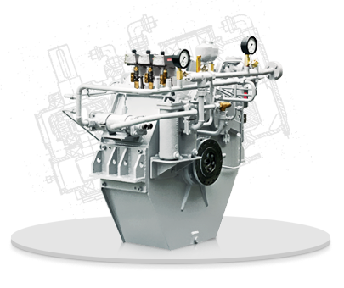
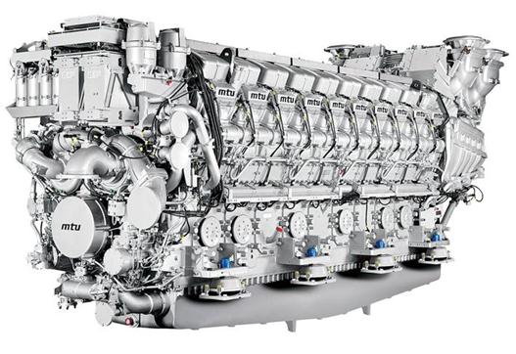
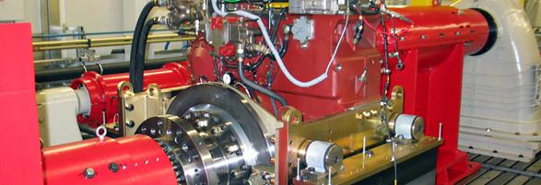
3Q BERHAD BUSINESS FOCUS – THE “PRODUCT”
DRIVING
DRIVEN
DRIVEN
Engine
Transmission System
Propulsion Equipment
Marine Power Equipment
Mechanical Power
Rotating Equipment
Construction Equipment
Mechanical Power System
Mining Equipment
Power Generation Equipment
Power Equipment
Notes:
3Q Berhad main focus is on the main component or the heart of any equipment which is the engine that provides the power

Slide 6
WHAT IS REMANUFACTURING?
REMANUFACTURING is a process of restoring old, used or worn out asset to As-Good-As-New condition.
A REMANUFACTURED COMPONENT;
Fulfills a similar function as the original part.
It is restored from an existing part (core) using standardized industrial processes in line with specific technical specifications.
Is given the same warranty as a new component and is clearly identified as a remanufactured component.
Notes:
This definition of remanufacturing is the most commonly used and accepted by various remanufacturing focused trade associations in Europe and America

Slide 7
REMANUFACTURING vs. OTHERS
Type of Work | Purpose | Start point | Extend of work | Methodology
Remanufacturing | Extend useful life | End of life | Component or system level | Extensive product recovery process
Refurbishment / Rebuilt | Extend useful life | Mid life or End of life | Equipment or vehicle | Complete revamp of systems (internals & externals)
Overhaul | Part of maintenance cycle | According to OEM service manuals | Component or system level | According to OEM service manuals
Recondition | Enhance resale value | Quarter of life | Equipment or vehicle | Brings to near-new look & feel only
Notes:
Based on the definition in the previous slide, Remanufacturing is not the same as refurbish, overhaul or recondition
We have categorized the differences into 4 categories, namely Purpose, Start Point, Extend of Work and Methodology

Slide 8
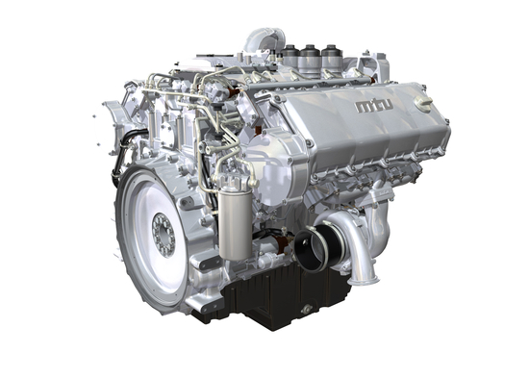
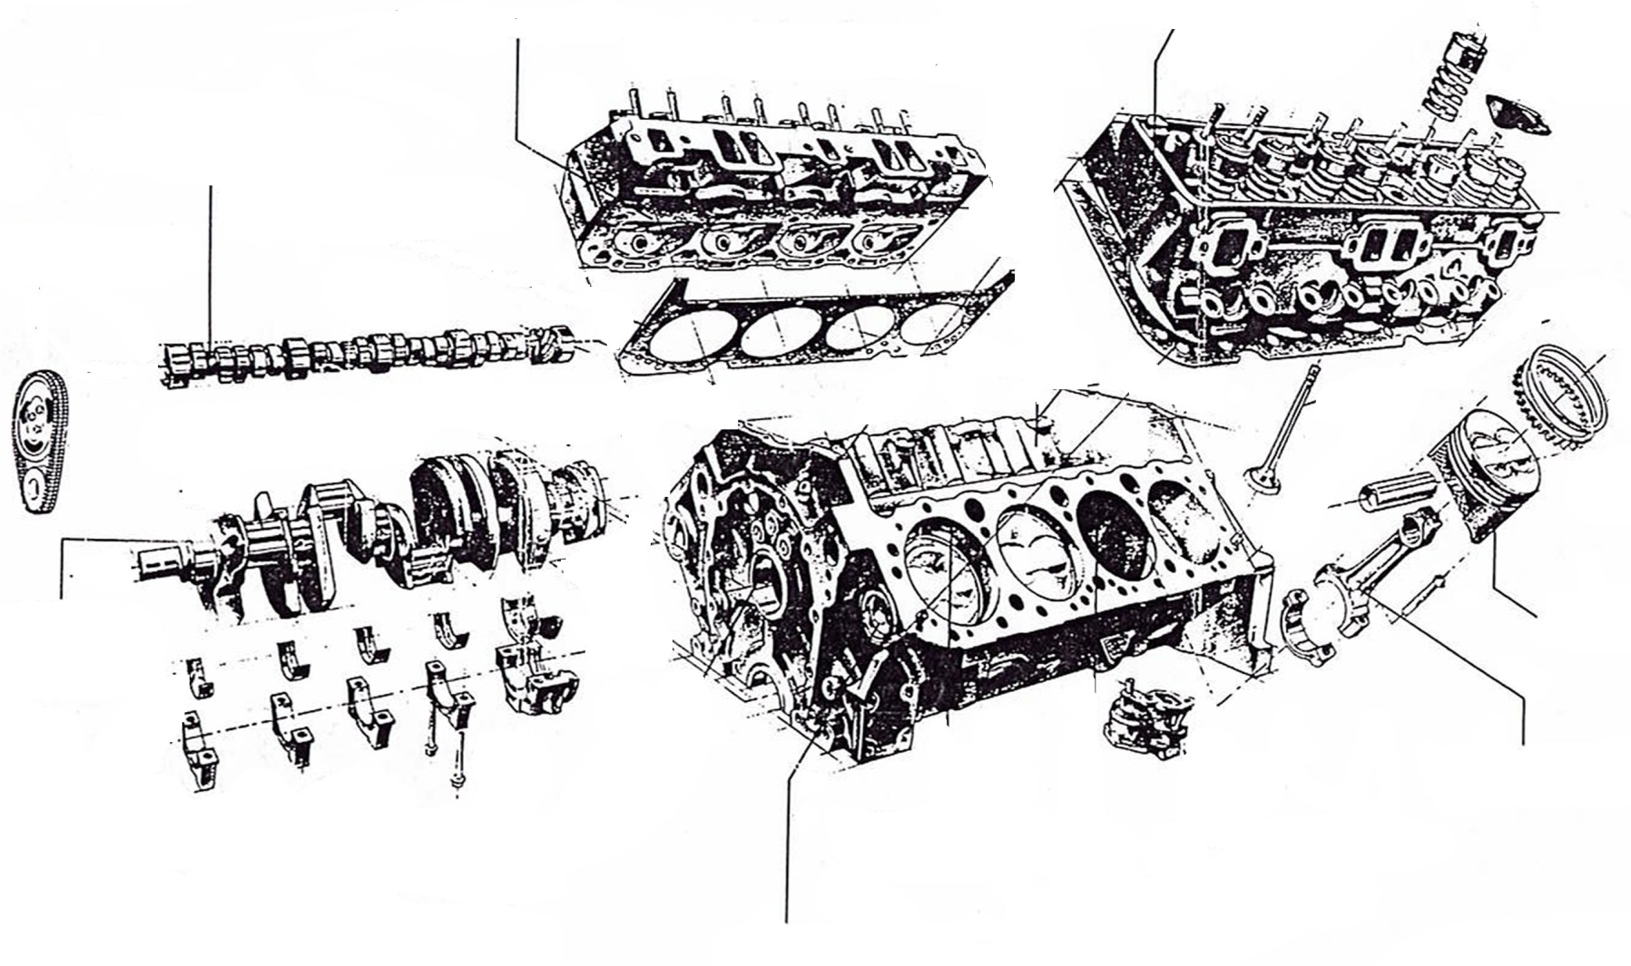
ENGINE SYSTEM
Cylinder head
Cylinder head
Camshaft
Crankshaft
Piston
Connecting Rod
Crankcase
Notes:
This is a typical configuration of a diesel engine
Remanufacturing focuses on the main components of the engine namely;
Crankcase
Crankshaft
Cylinder heads
Camshaft
Connecting rods

Slide 9
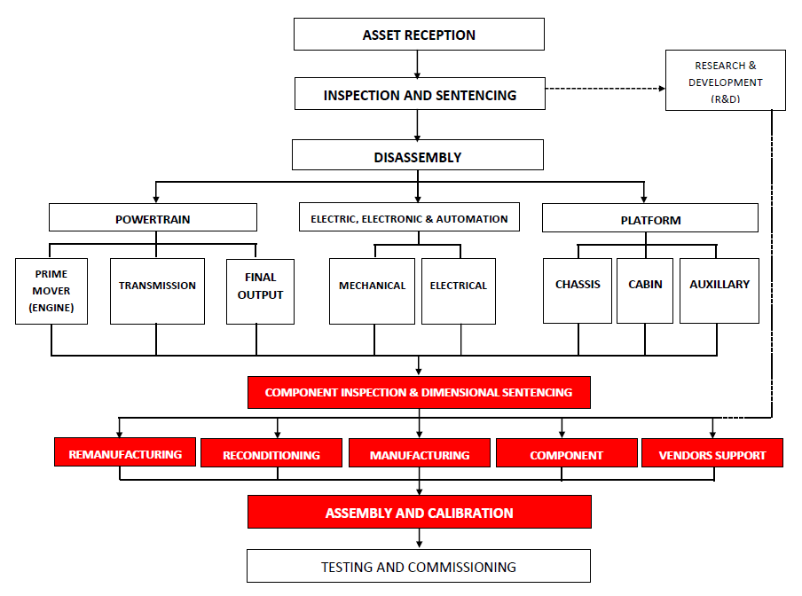
MTI REMANUFACTURING PROCESS
TESTING & COMMISSIONING
Notes:
This is an overview of the MTI remanufacturing process for any systems that we take in
Critical areas are higlighted in red where high techical skill and know how is required to ensure core usability is correctly identified

Slide 10
SKILL AND COMPETENCY
High
Remanufacturing
Refurbishment
Skill
& Competency
Recondition
General
Low
Notes:
The skill and competency level increases from the bottom to the top of the pyramid.
The number of players decreases from the bottom to the top of the pyramid

Slide 11
MULTI SECTORS CAPABILITIES
Industrial
Industrial
Industrial
Land Transport
Land Transport
Land Transport
Land Transport
Land Transport
Marine
Marine
Marine
Marine
Marine
Marine
2006
2007
2008
2009
2010
2011
YEAR
Notes:
MTI has increases its penetration into different market segments since 2006.
This year, we are adding the Oil & Gas market on top of existing markets that we serve

Slide 12
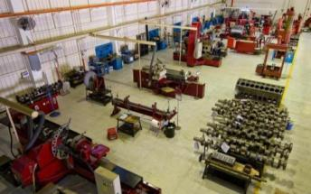
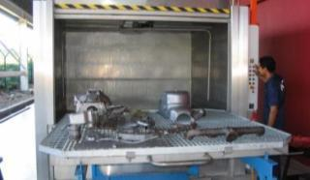
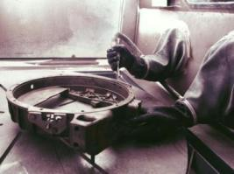
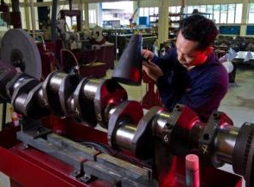
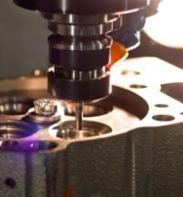
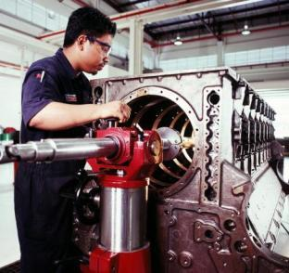
REMANUFACTURING FACILITY
Cleaning
Precision Machining Center
Soda Blasting
CNC Machining
Crankcase machining

Slide 13
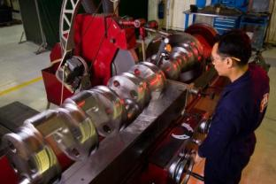
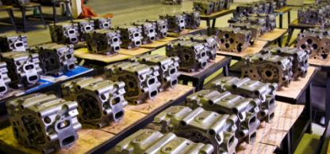
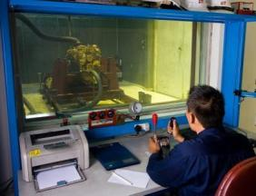
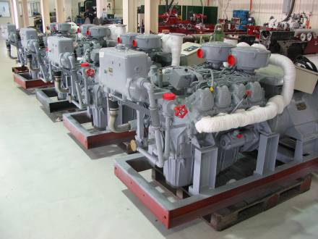
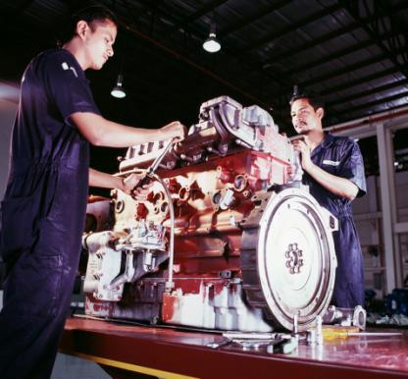
REMANUFACTURING FACILITY
Cylinder head remanufacturing
Engine Testing
Crankshaft machining
Engine assembly
Completed engines

Slide 14
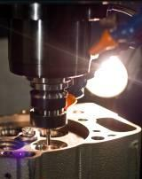
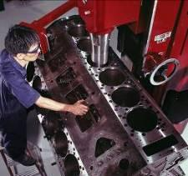
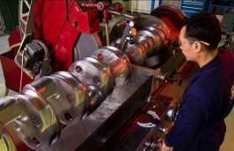
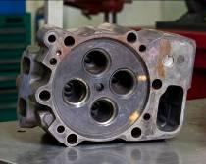
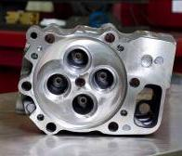
REMANUFACTURING EXPERIENCE
Cylinder Head Reman
Crankcase machining
Before
After
Crankshaft machining

Slide 15
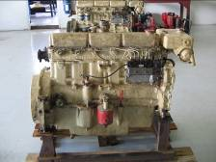
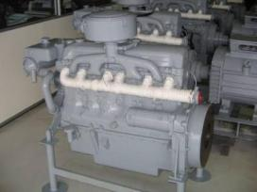
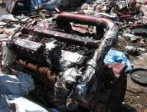
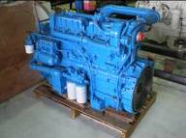
REMANUFACTURING EXPERIENCE
BEFORE
AFTER
MMEA
Marine Generators
PRASARANA IVECO engines for buses
Notes:
MMEA marine generators
MTI provides the necessary remanufacturing services on MMEA marine generators to ensure their vessels are at a high operational readiness
Cost savings for MMEA as they reduce the need to purchase new generators
PRASARANA
Awarded the contract to remanufacture 146 IVECO engines for city bus application
Completed in 6 months

Slide 16
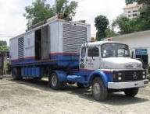
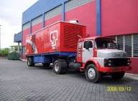
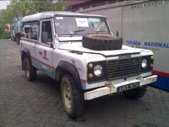
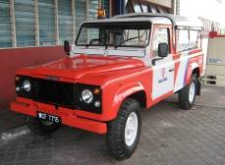
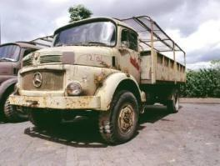
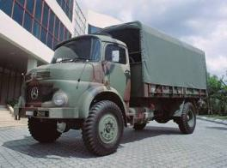
REMANUFACTURING EXPERIENCE
BEFORE
AFTER
TNB
Mobile Generator Set
TNB
Land Rover Defender
ARMY
Mercedes Benz 911
Notes:
TNB Mobile Generator
Remanufactured over 8 mobile generators
Cost savings for TNB as they reduce the need to purchase unit
Improved their readiness as the turnaround to remanufacture the generators is faster than building a new unit (6 months vs. 1.5 years)
TNB Land Rover Defenders
Remanufactured over 12 units of Land Rover Defenders for TNB
Cost savings, 40% of the cost of new
ARMY MB911
Remanufactured 100 units for Malaysia Army
Aged over 25 years old and was non operational condition, waiting to be sold off as scrap

Slide 17
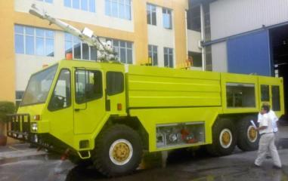
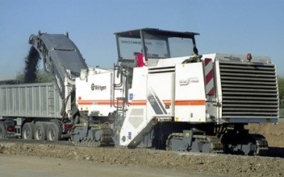
REMANUFACTURING EXPERIENCE
Malaysia Airports Berhad
Airport Fire Tender
Wirtgen Malaysia
Cold Milling Machine
Notes:
Malaysia Airports Berhad
Refurbished over 7 airport fire tenders
Cost savings, 40% of the cost of new replacement
Quicker turnaround time for remanufacturing (8 months vs 2 years)
Vehicles aged over 15 years

Slide 18
BENEFITS OF REMANUFACTURING
Cost savings – extend the useful life of assets & reduce the need for new purchase
Remanufacturing is a viable industry to develop Small & Medium Size Enterprises (SME) infrastructure requirements as well as extending the life of their assets
Remanufacturing as a green technology that re-uses materials and machined to OEM specifications
Remanufacturing can be applied at a component level as well as full built up equipment
Provides security of supply of parts to asset owners
Allows for high-technology maintenance companies to be able to support OEM products beyond its useful life and better manage obsolescence management
Will create jobs for the vocational communities both in mechanical and electrical engineering, enhance skill to expertise level and hence creating a multiplier effect in the economy
Notes:
R

Slide 19
S4000 Cylinder Head & Crankcase Remanufacturing Project

Slide 20
Brief On Remanufacturing Scope Of Work
A 26 step Remanufacturing process (compared to 4 steps in overhaul)
Return a used cylinder head to zero hours with a warranty to match
Over 3,000 units produced with zero defects in the field

Slide 21
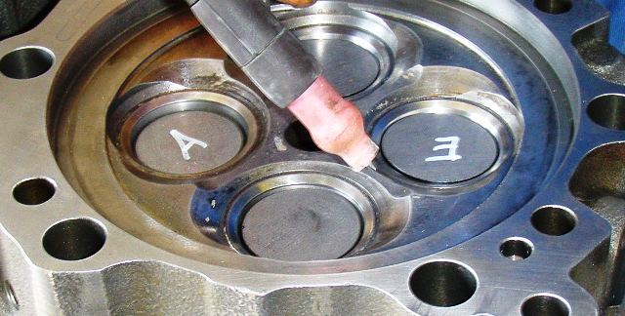
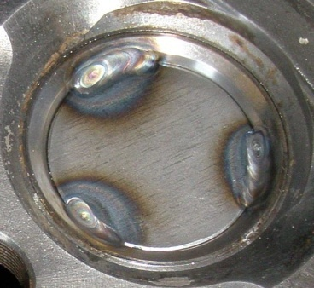
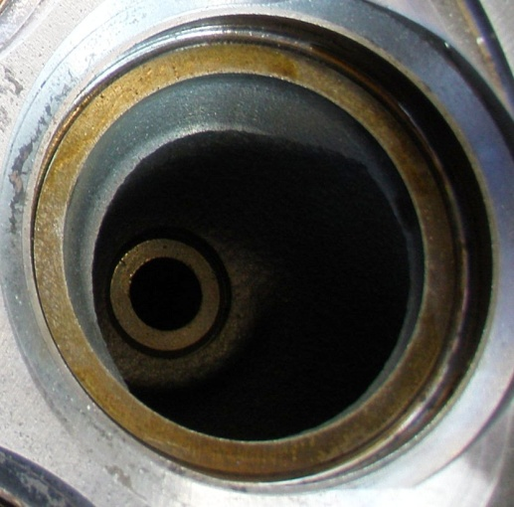
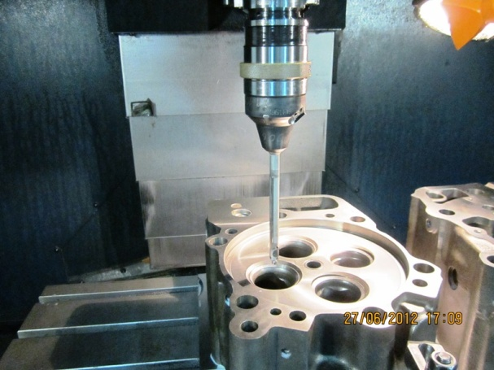
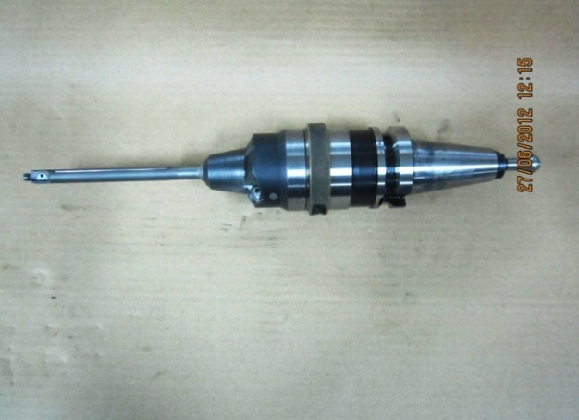
S4000 Cylinder Head Valve Seat

Slide 22
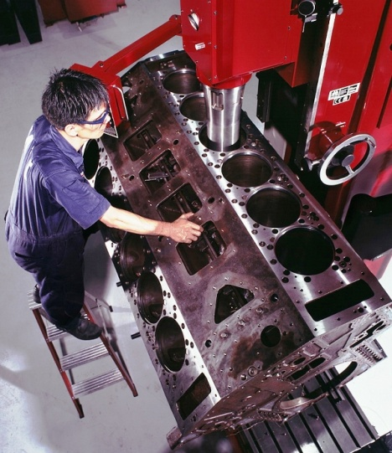
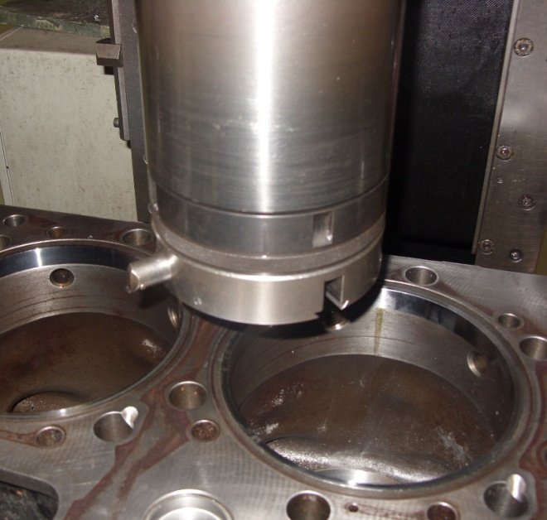
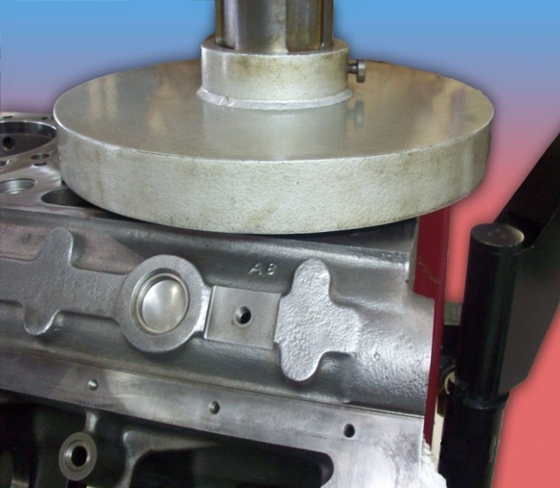
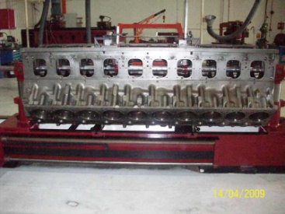
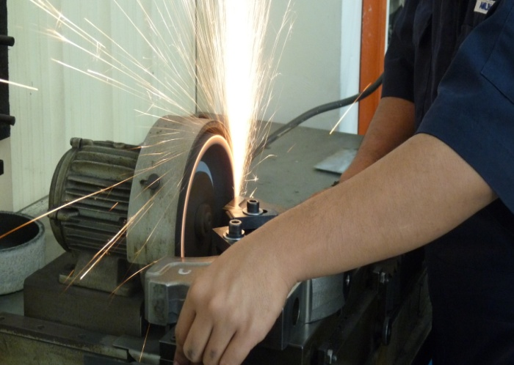
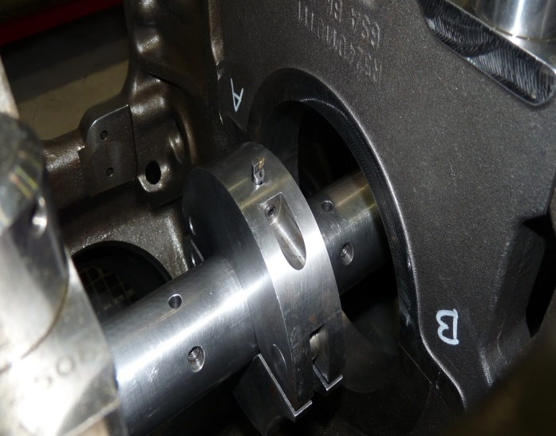
S4000 Crankcase Remanufacturing

Slide 23
Evolution of the S4000 Cylinder Head Remanufacturing Machining Process
2009
2009
2010
2011
Valve seat machine
Hand tool
Special tools
Factory tools
Limited capability in cutting valve seat
Factory standard machine for repair
Cutting of valve seat and guide simultaneously by using conventional reamer
State of the art tool in accordance to factory standard.
Utilizing different holder and cooling system
Critical tolerance: i. Valve seat angle 0-30min tolerance
ii. Valve seat round out max 0.04mm
Notes:
We have progressively developed the remanufacturing process for the S4000 cylinder head remanufacturing.
Improving both the quality and also capacity over the last 4 years.
Capacity from 50 units per month in 2009 to 150 units per month in 2011, with no major capital investment

Slide 24
CHALLENGES
Local technical skill
Certification by independent body
Market acceptance for remanufactured goods
Design for remanufacturing products
Reverse logistics – core collection
Core usability for remanufacturing
Notes:
There is insufficient local technical skill and expertise on our area of business as remanufacturing demand a higher technical skill and knowledge
There is a need for an independent certification body that could certify the quality or remanufactured products in Malaysia or internationally
As remanufacturing is still new in Malaysia, the market acceptance is still low but it is slowing changing. Certification from an independent body will certainly help in increasing market acceptance
Not all products can be remanufactured as some are not designed to be. Adding remanufacturing requirements at the product design stage will help increases the volume of remanufacturing
Core collection is still in its infancy in Malaysia. The mechanism that involves all stakeholders needs ot be established. This included asset owners, core collectors, logistic provider and remanufacturers
With products not designed for remanufacturing, core usability is reduced. As an example, only 40% of cores for the cylinder head remanufacturing that we do passes the incoming inspection and can go though the remanufacturing process

Slide 25
Q & A

