Slide 1
Presented by
Shahanom Uthman
Head (Project & Service)
22nd Oct 2012

Slide 2
OUR BUSINESS MODEL
Service, Repair, Refurbish
- Remanufacturing
Scrap old transformers
Installation & Commissioning
MANUFACTURING
SERVICES
“A One Stop
Transformer
Solution
Provider”
Design to specifications
Selling
Production

Slide 3
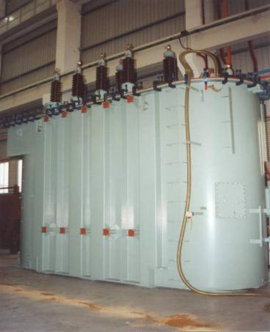
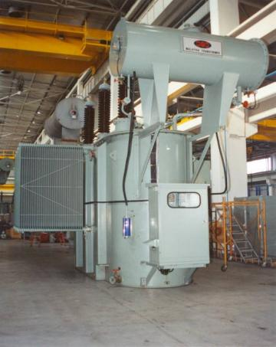
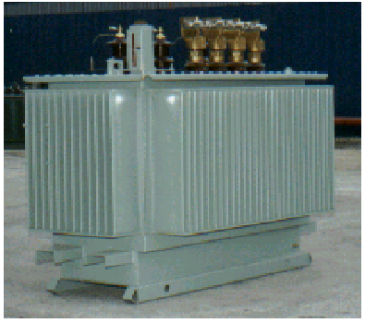
PRODUCT LINES
DISTRIBUTION -
System 100kVA to 3000kVA 11kV to 33 kV
TRANSMISSION -
System 7.5MVA to 90MVA 33kV to 132kV
300 kVA 33/.415 kV Earthing transformer
30MVA 33/11kV
90MVA 132/66kV-ONAF
1000kVA 11/.433 kV
Hermetically sealed type Transformer
2000 kVA 11.4/.433 kV transformer conservator type
30MVA 132/11kV ONAF

Slide 4
PLANT CAPACITY...
Power Transformers
5000 MVA/year
Distribution Transformers
2500 MVA/year

Slide 5
REMANUFACTURING CAPACITY
COMBINED DISTRIBUTION AND POWER TRANSFORMER
700 MVA

Slide 6
MTM REMANUFACTURING PROCESS
Diagnose and investigate
Trouble shoot
Re design and drawing preparation
Material ordering
Reassemble
Testing
Customer witness
Delivery
Note: All remanufacturing process follow normal QA requirement and check points

Slide 7
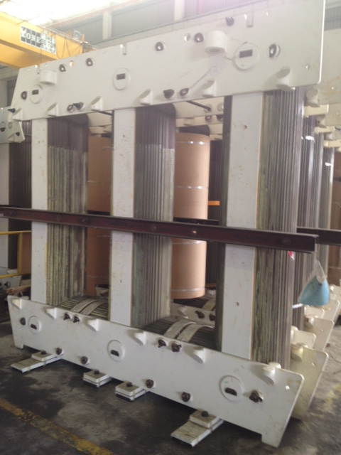
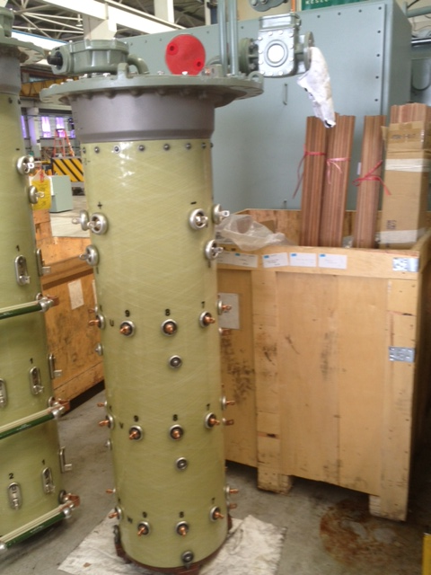
MAJOR TRANSFORMER COMPONENTS
Grain Oriented Steel - CORE
Tap changer

Slide 8
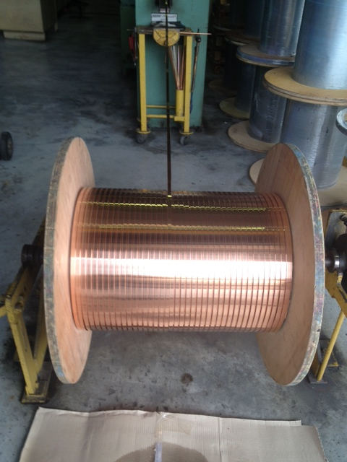
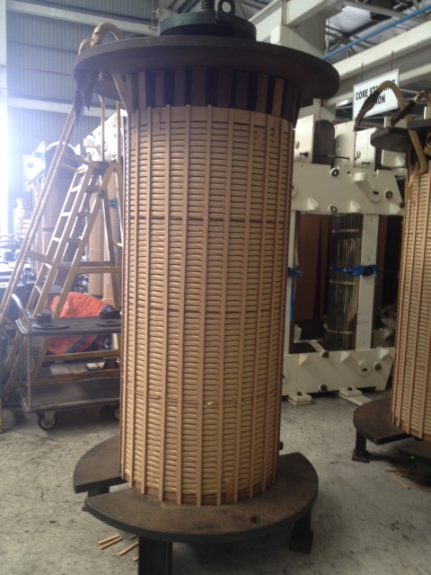
MAJOR TRANSFORMER COMPONENT
Copper Winding

Slide 9
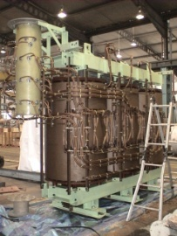
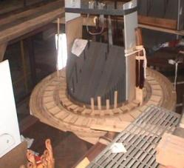
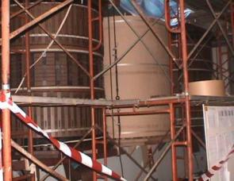
TRANSFORMER ACTIVE PART DURING REMANUFACTURING PROCESS

Slide 10
COMPLETE ACTIVE PART AFTER REMANUFACTURING
Complete Assemble of
Transformer Active Part

Slide 11
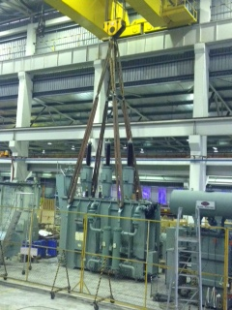
TRANSFORMER COMPLETE WITH TANK AFTER REMANUFACTURING

Slide 12
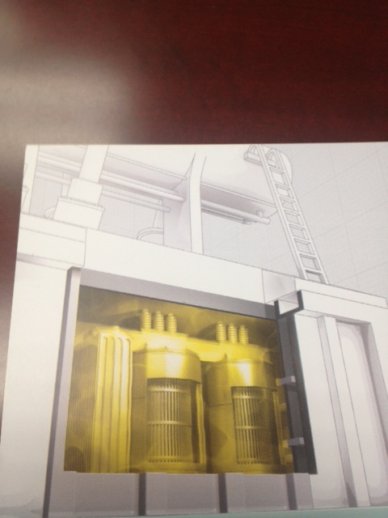
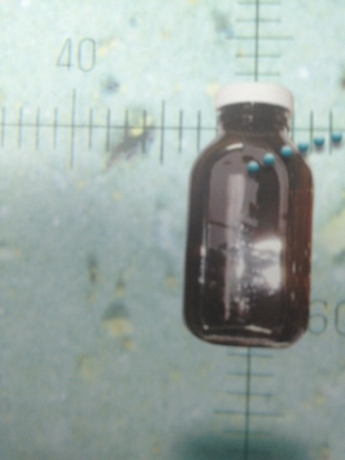
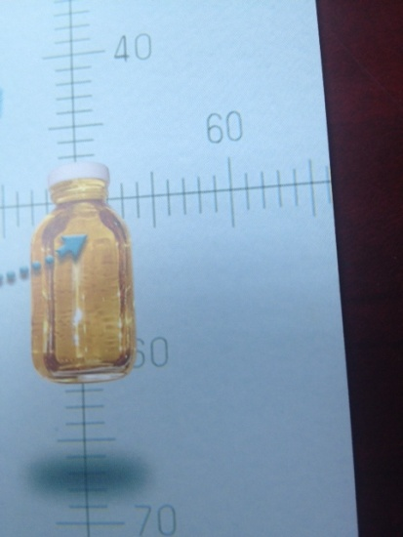
TRANSFORMER INSULATION MEDIUM
Condition of transformer oil after
some years in operation
Condition of transformer oil in new transformer
Cut out view of transformer active part in oil

Slide 13
SITE SERVICING WORKS
UPGRADE TRANSFORMER ACCESSORIES –
AIRBAG INSTALLATION IN TRANSFORMER CONSERVATOR
REPLACEMENT OF BUSHINGS, COOLING FAN ETC
REPLACEMENT AND SERVICING ON LOAD TAPCHANGER
2. PERFORM MECHANICAL WORKS
I. FIX WELDING LEAKS
II. CABLE BOX INSTALLATION

Slide 14
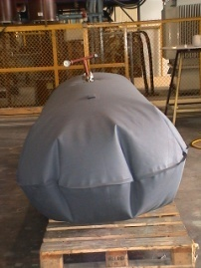
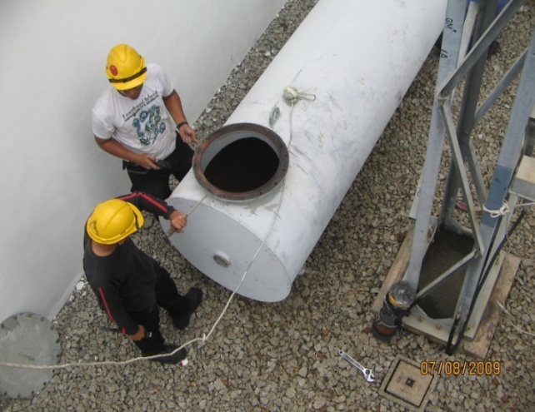
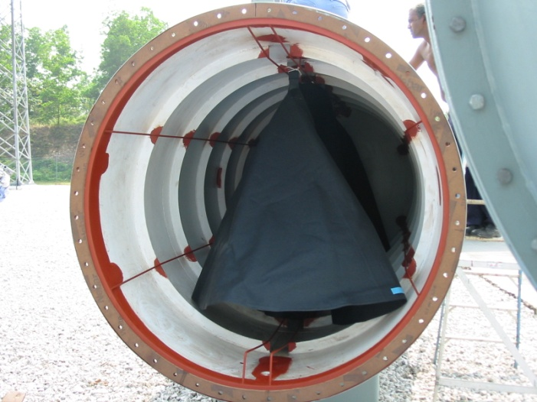
SITE SERVICING
Replacement of air bag

Slide 15
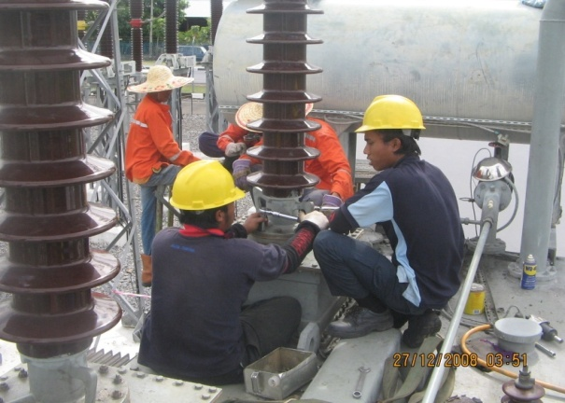
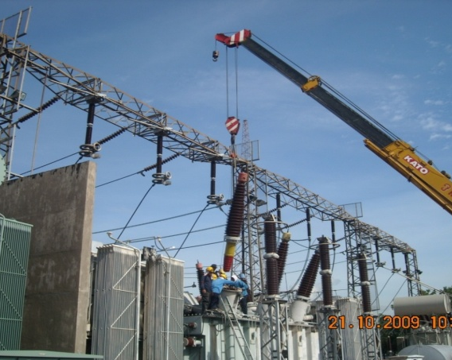
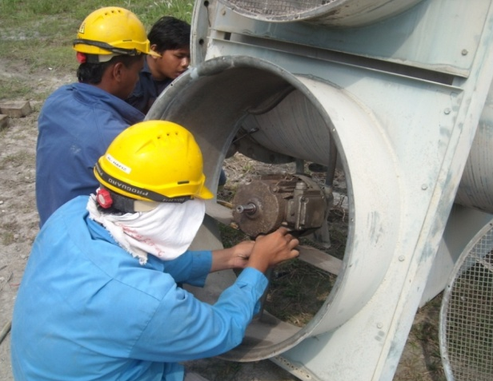
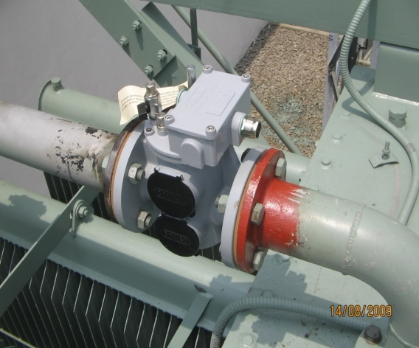
SITE SERVICING
Replacements of..
Gasket
Bushing
Cooling
Fan
Bucholz
Relay

Slide 16
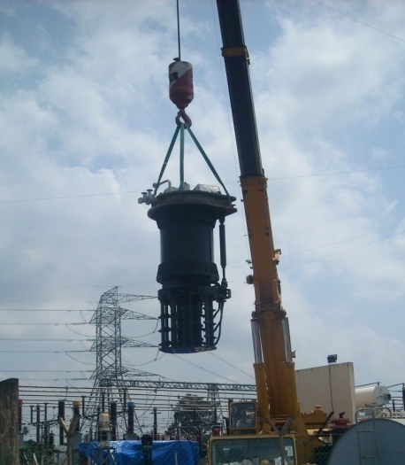
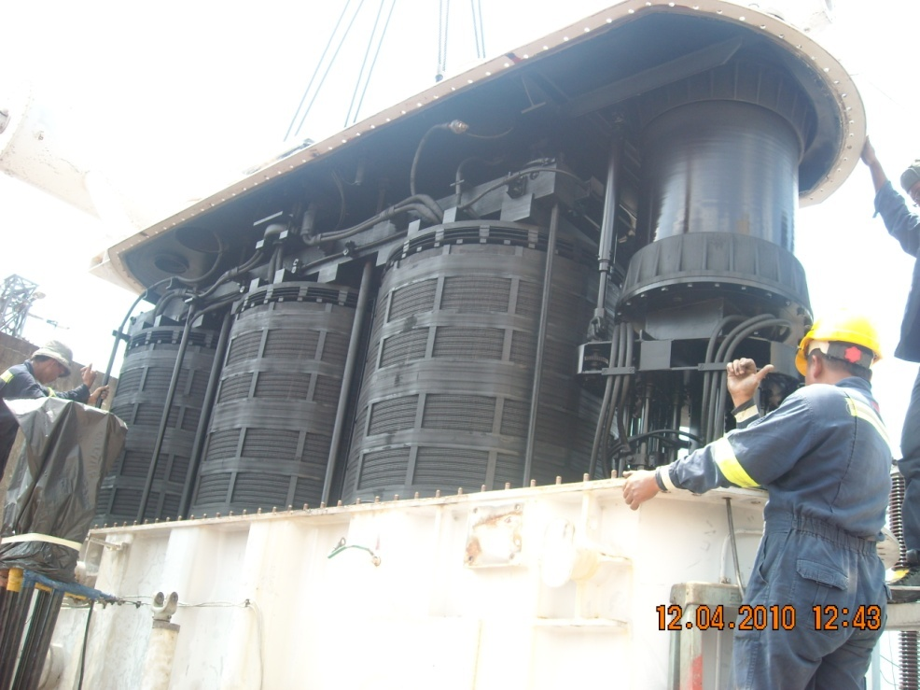
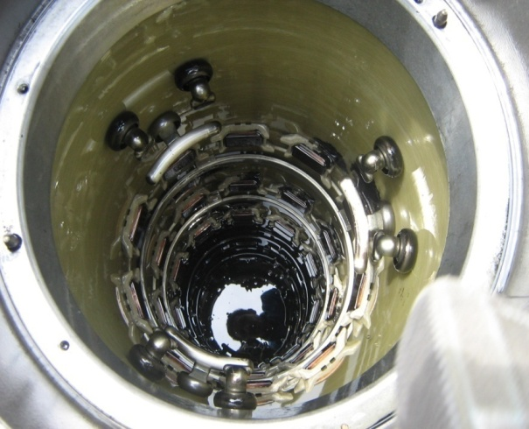
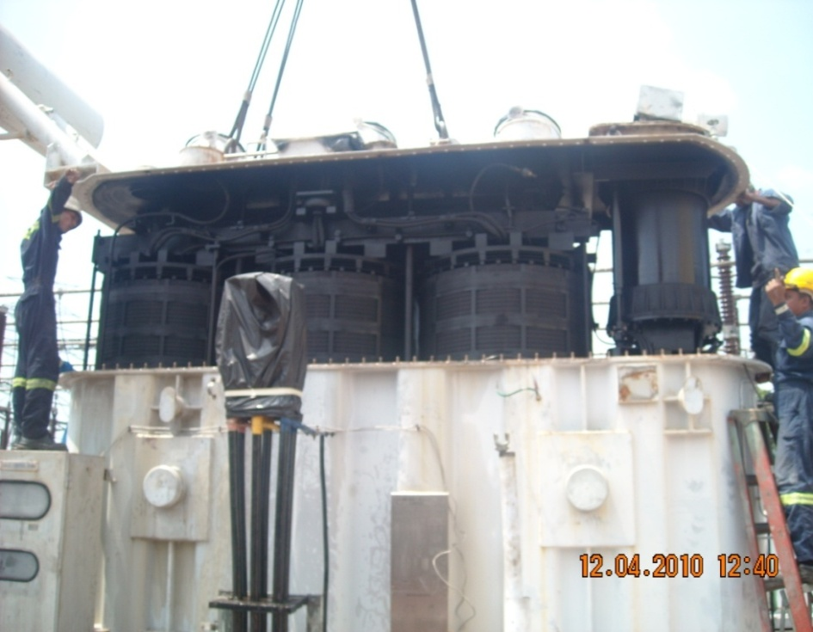
SITE SERVICING
Replacement & Servicing OLTC

Slide 17
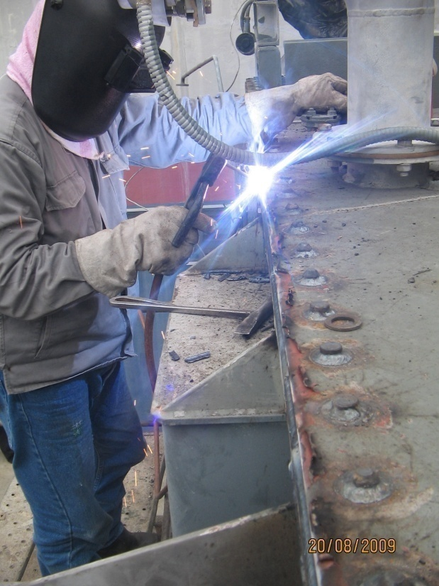
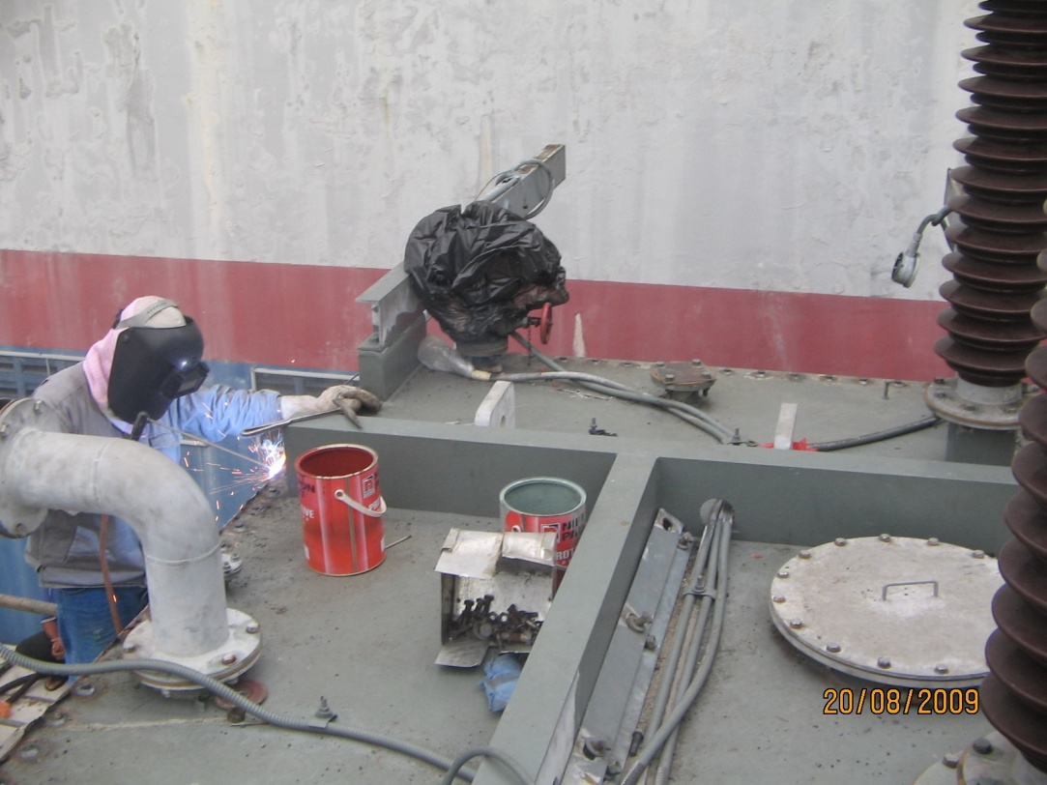
SITE SERVICING
Repair of welding leaks

Slide 18
REMANUFACTURING BENEFITS
ASSIST THE EQUIPMENT OWNER TO EXTEND PRODUCT LIFE CYCLE
REMANUFACTURING WORK IS GOOD AS NEW PRODUCT
SAVE THE COMPANY IN TERM OF CAPITAL EXPENDITURE
NURTURE PRODUCT INNOVATION
REDUCE ENERGY CONSUMPTION BY PROMOTING USAGE OF REMANUFACTURING GOODS

Slide 19
ISSUES TO WATCHOUT
MANAGEMENT OF TRANSFORMER SCRAP COMPONENTS NEED TO BE HANDLED
PROPERLY SO AS NOT TO POLLUTE THE ENVIRONMENT I.E. OIL
REMANU PRODUCT MAY HURT FRESH PRODUCT BUSINESSES
CONCERN ON CUSTOMER SATISFACTION TOWARD REMANUFACTURING RELIABILITY ESPECIALLY ON QUALITY – CANNOT MATCH WITH OEM PERFORMANCE

Slide 20
THANK YOU

